Slide 1
Big Game
Small Game
Waterfowl & Migratory Game Birds
Furbearers
State Game Lands
10
10
10
10
10
20
20
20
20
20
30
30
30
30
30
40
40
40
40
40
50
50
50
50
50

Slide 2
Category 1: Big Game

Slide 3
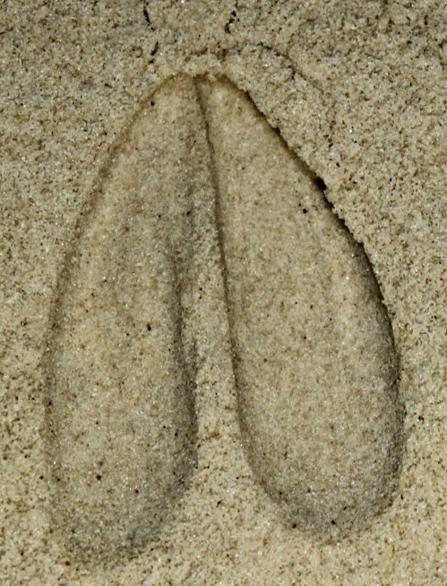
Big Game
Who does this track belong to?
Photo courtesy of: Mandy Marconi
10

Slide 4
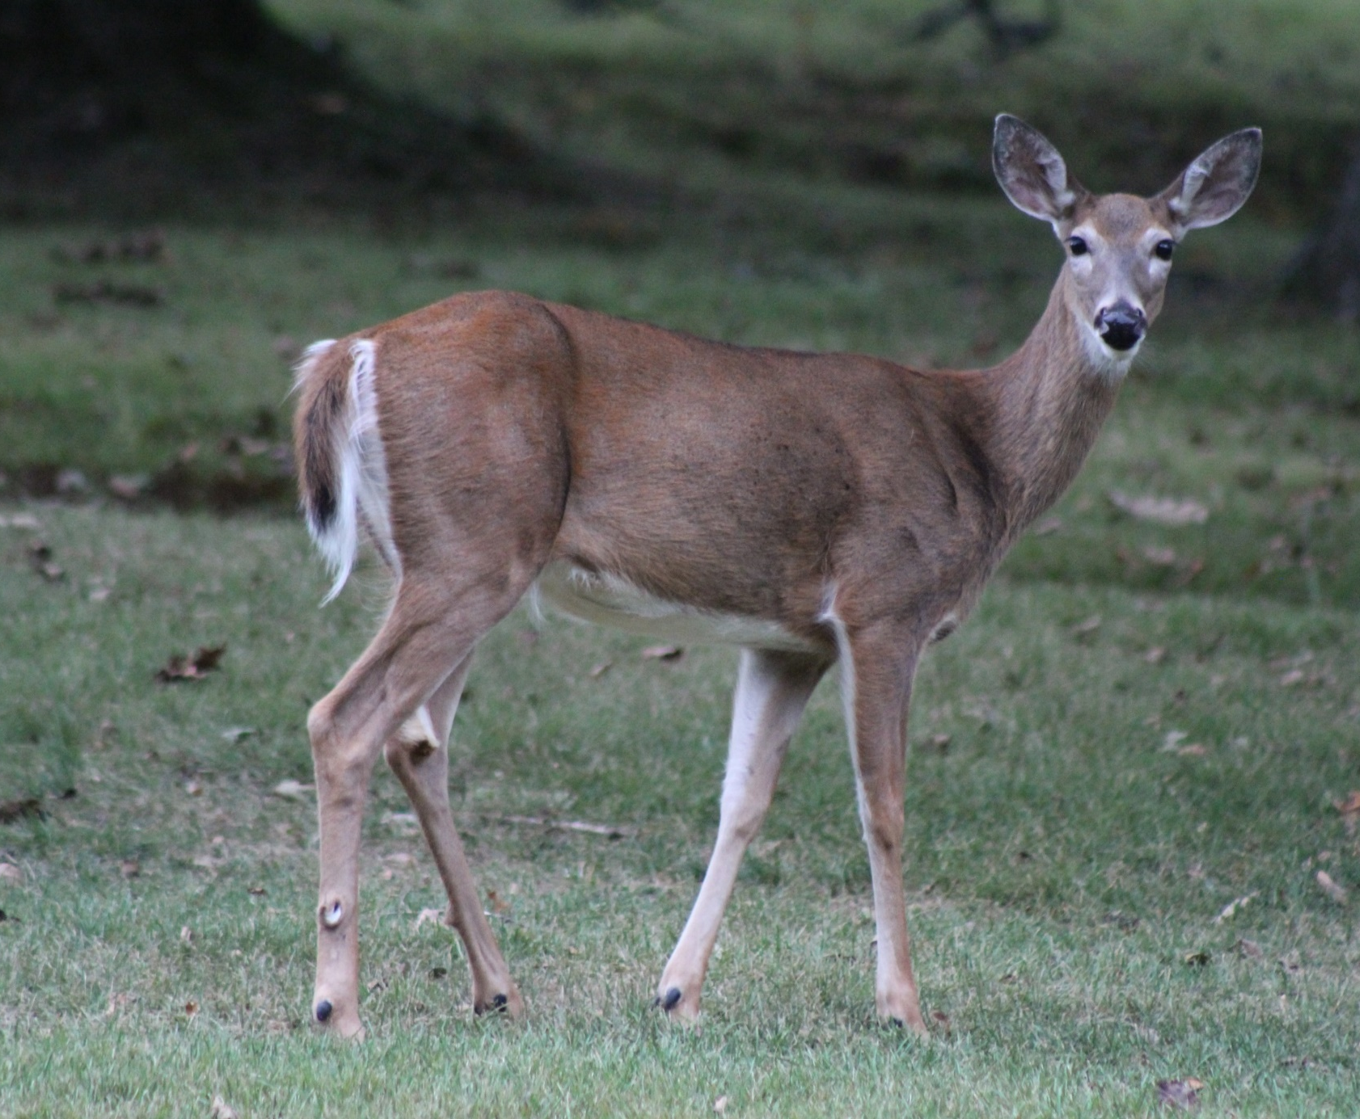
Big Game
White-tailed deer
Photo courtesy of: Mandy Marconi
10

Slide 5
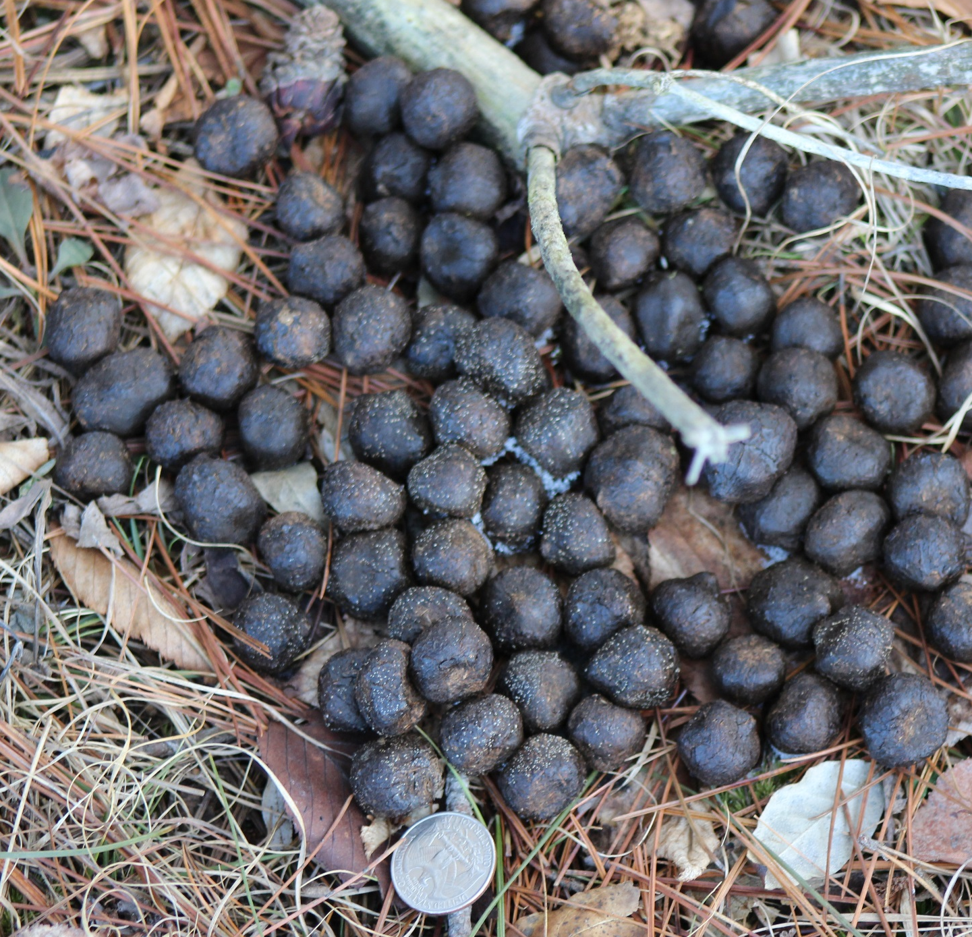
Big Game
What animal left this scat behind?
Photo courtesy of: Mandy Marconi
20

Slide 6
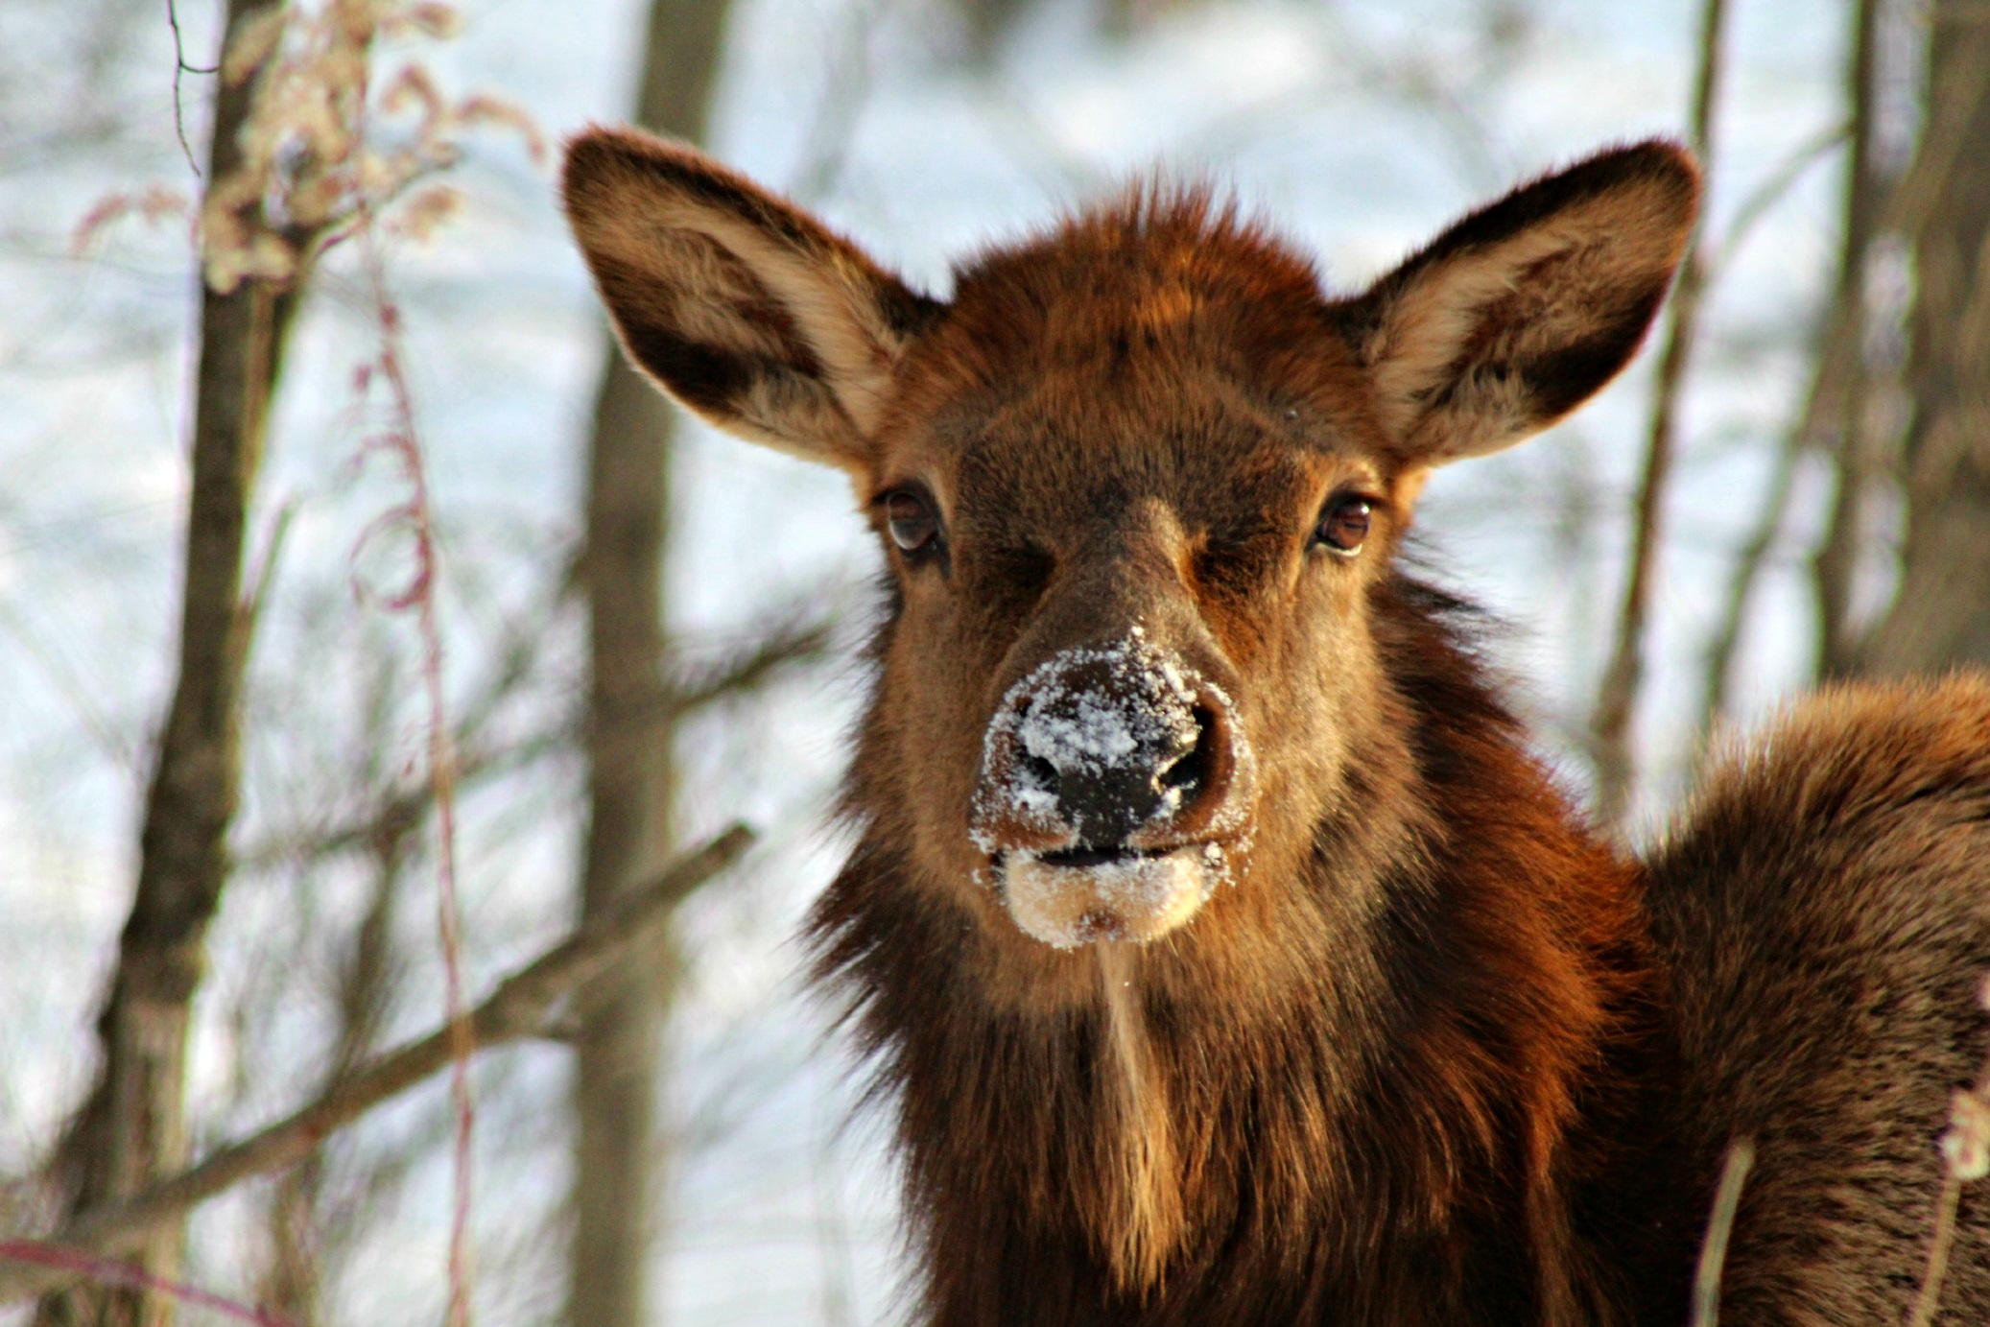
Big Game
Elk
Photo courtesy of: Mandy Marconi
20

Slide 7
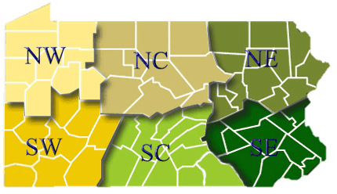
Big Game
What is Pennsylvania’s state mammal
30

Slide 8
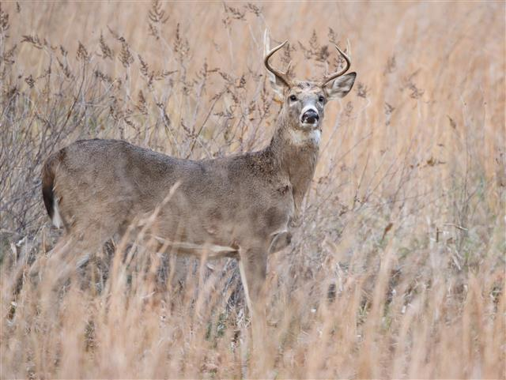
Big Game
The white-tailed deer
Photo courtesy of: Jacob Dingel
30

Slide 9
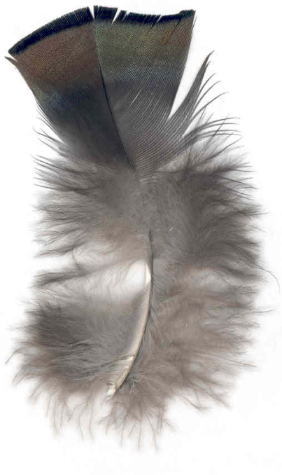
Big Game
Who does this breast feather belongs to? Include gender.
Photo courtesy of: PGC SE Wildlife Sign PPT
40

Slide 10
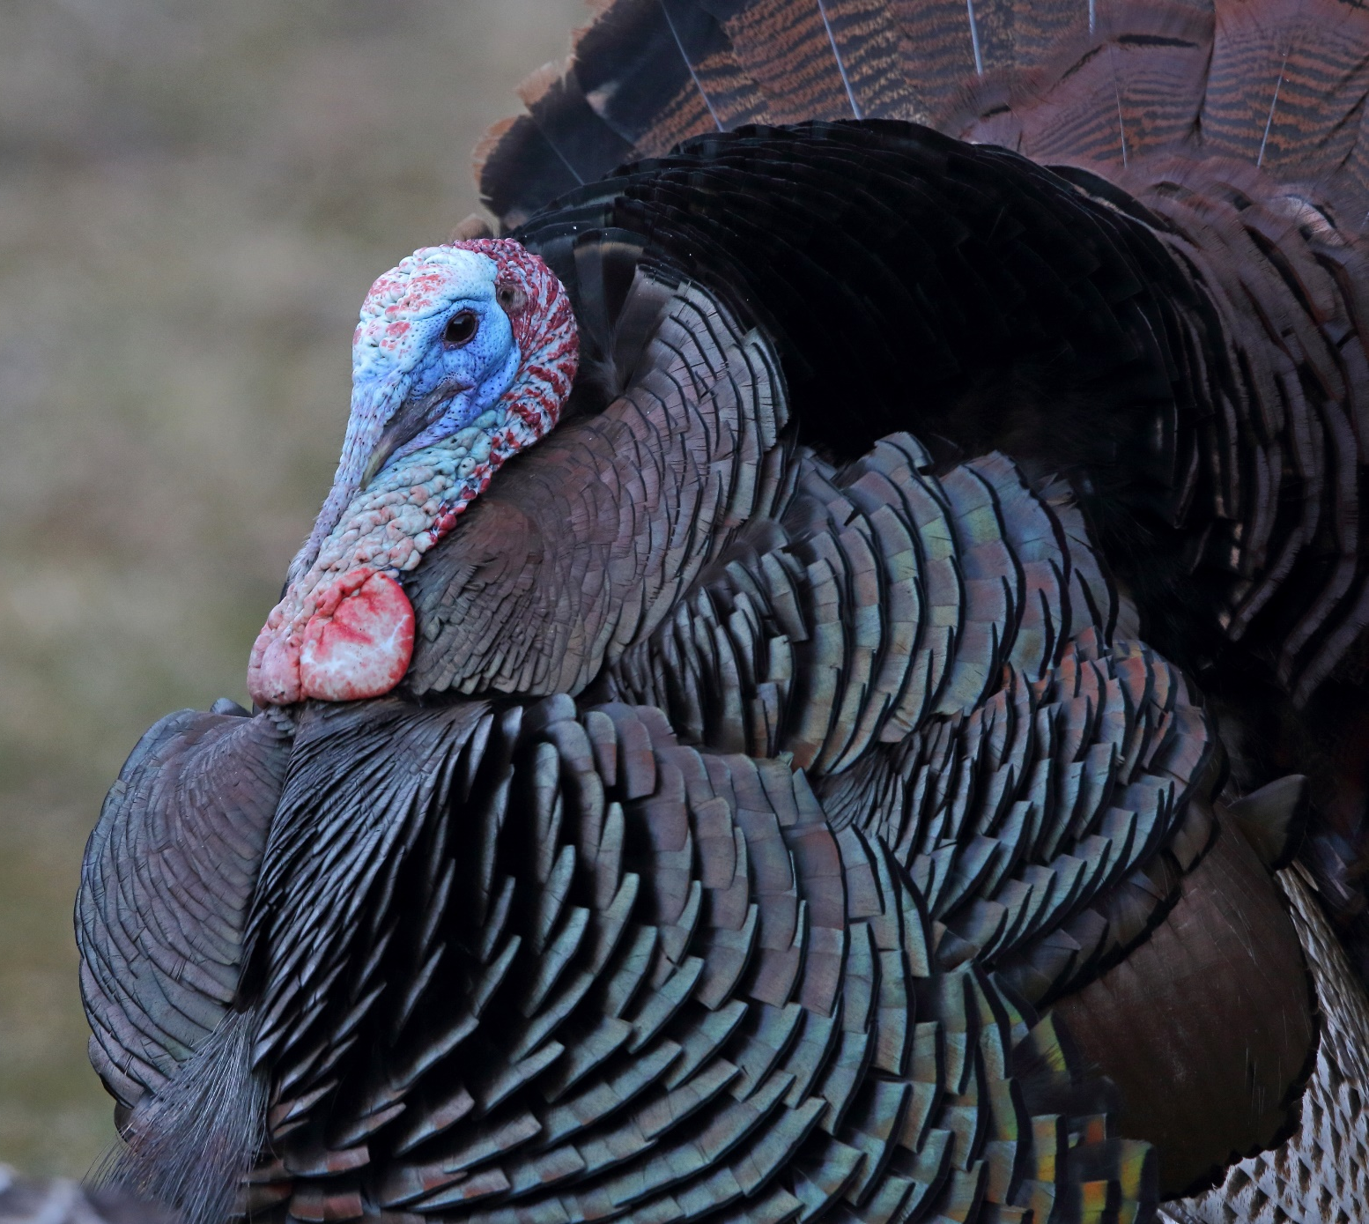
Big Game
Male, eastern wild turkey
Photo courtesy of: Jacob Dingel
40

Slide 11
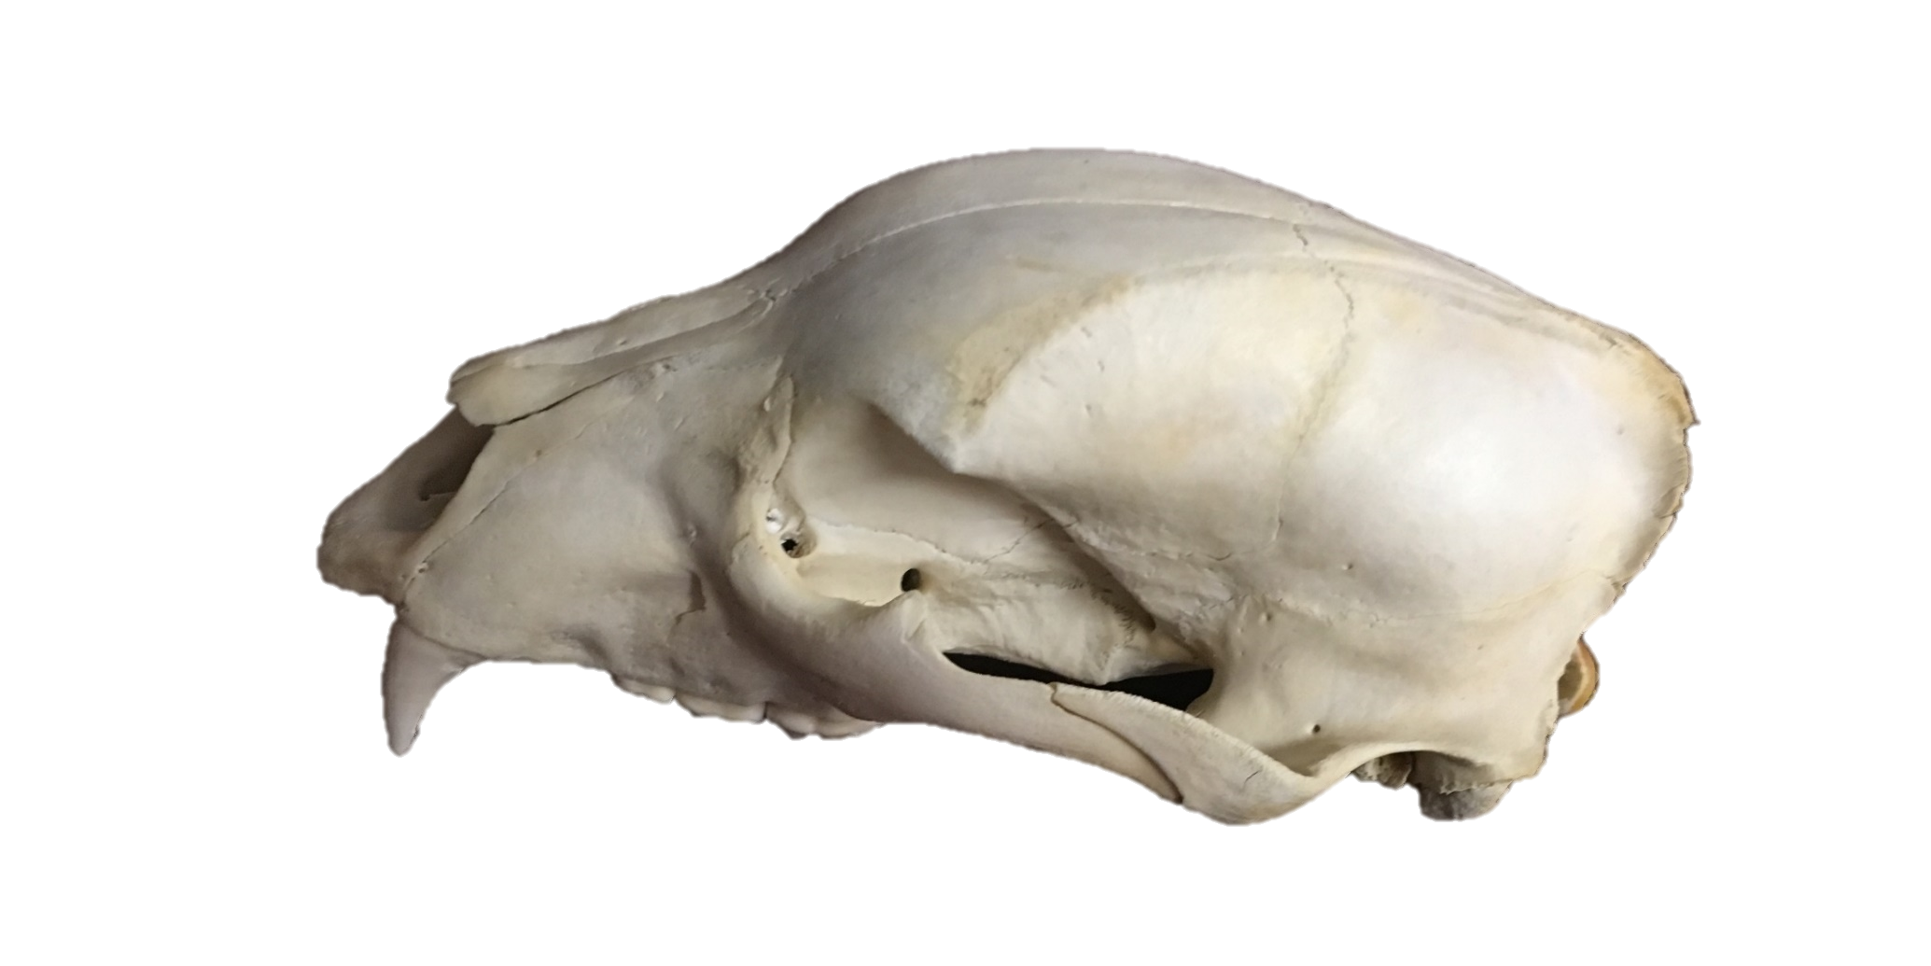
Big Game
What Pennsylvania animal does this skull belong to?
Total teeth: 42
Skull length: about 10”
Photo courtesy of: Mandy Marconi
50

Slide 12
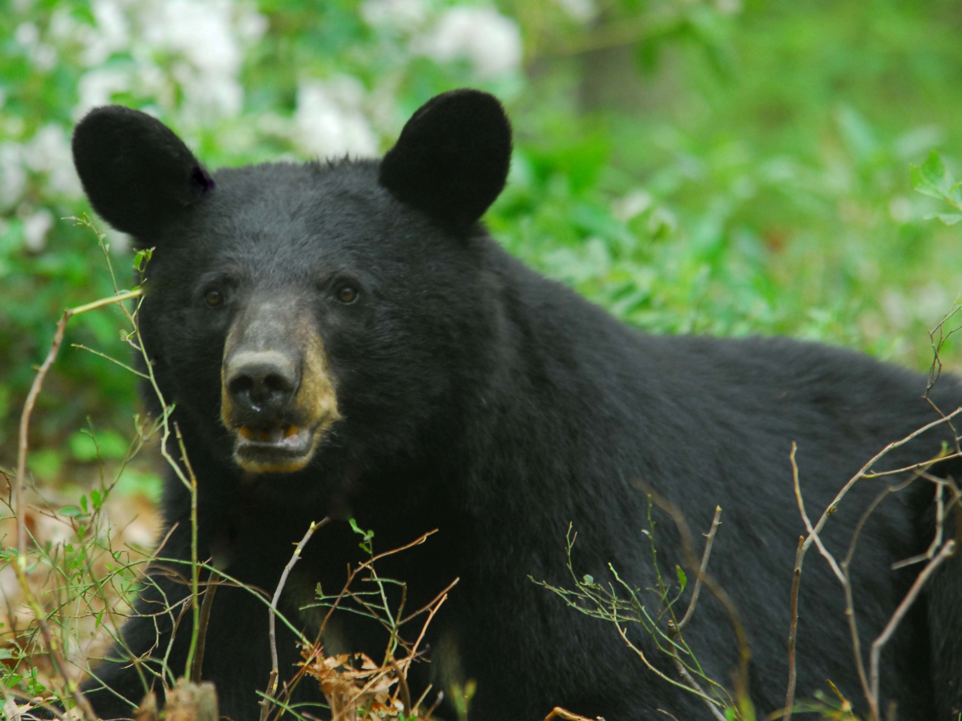
Big Game
Black bear
Photo courtesy of: Hal Korber
50

Slide 13
Category 2 questions follow

Slide 14
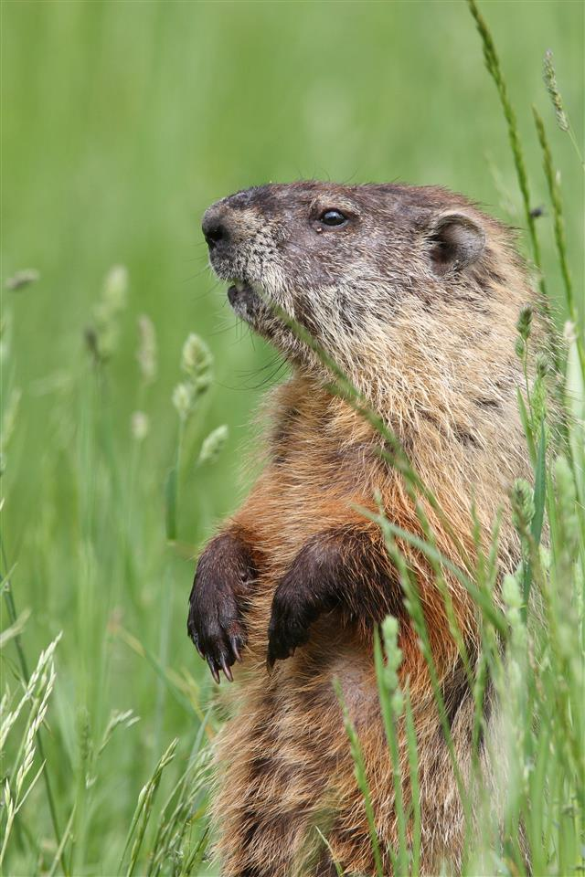
Small Game
What is this animal?
Photo courtesy of: Jacob Dingel
10

Slide 15
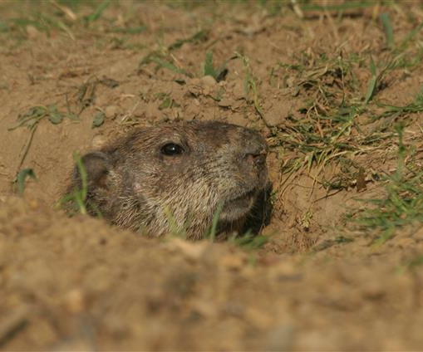
Small Game
It is a woodchuck. It is also known as a groundhog, chuck, whistle pig, marmot, and monax.
Photo courtesy of: Jacob Dingel
10

Slide 16
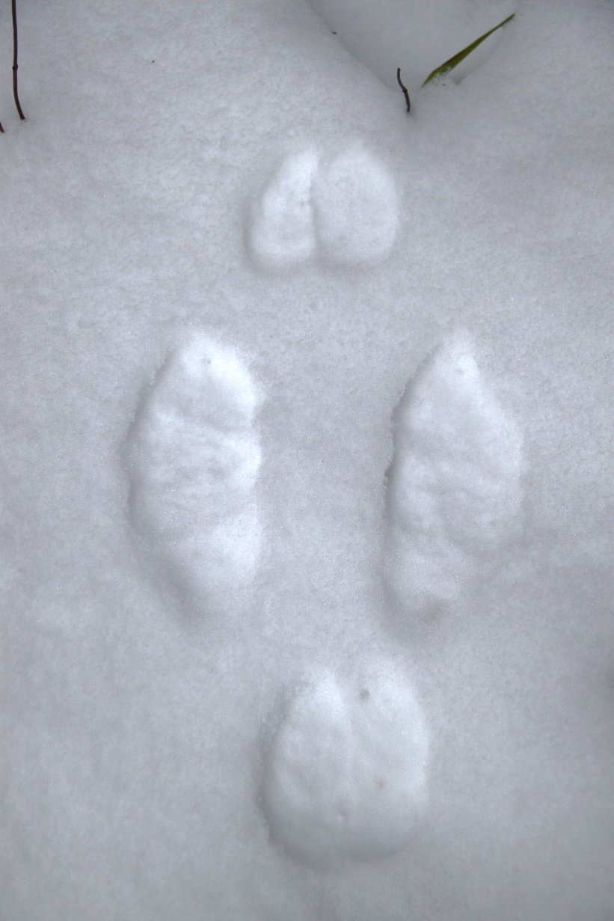
Small Game
The bottoms of my toes and the soles of my big feet are covered with coarse hair that grows long in winter, which supports me in deep snow and gives me traction on icy crusts. Who am I?
U. S. Fish and Wildlife Service - Northeast Region / Public domain
20

Slide 17
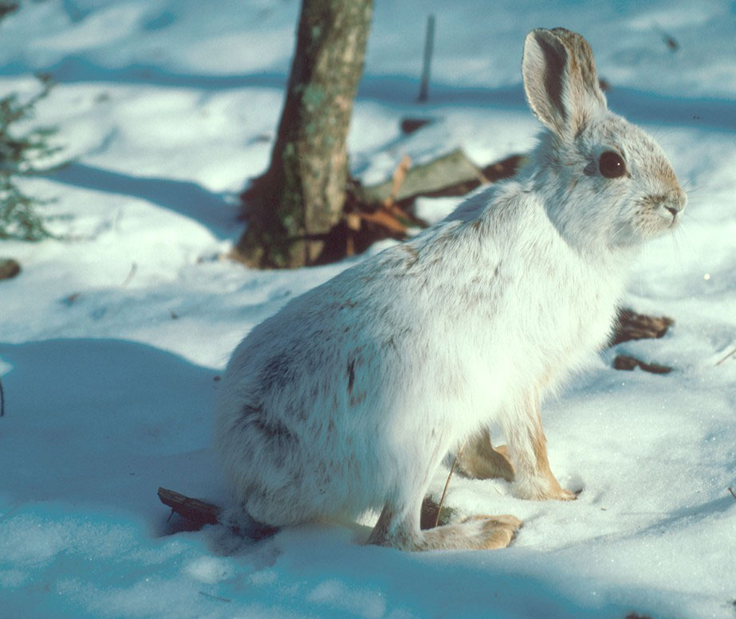
Small Game
Snowshoe hare
Photo courtesy of: Hal Korber
20

Slide 18
Small Game
True or False: Porcupine quills are specialized hairs that cannot be thrown?
Photo courtesy of: Jacob Dingel (cropped)
30

Slide 19
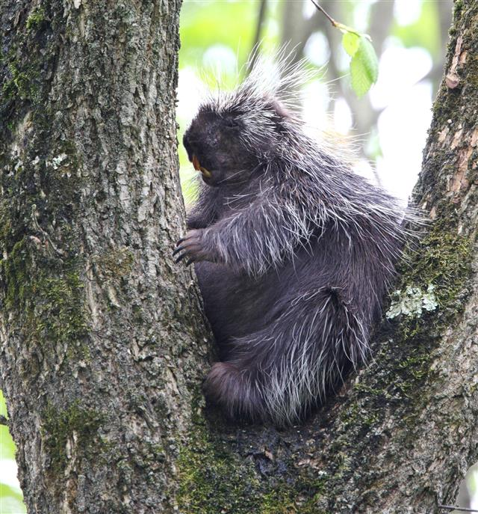
Small Game
True
Photo courtesy of: Jacob Dingel
30

Slide 20
Small Game
I am the only native quail in the East. Who am I?
Photo courtesy of: Jacob Dingel (cropped)
40

Slide 21
Small Game
Northern
bobwhite
Photo courtesy of: Jacob Dingel
40

Slide 22
Small Game
During winter, my feet develop snowshoe-like properties through the growth of a horny fringe around the toes. Who am I?
Photo courtesy of: Jacob Dingel (cropped)
50

Slide 23
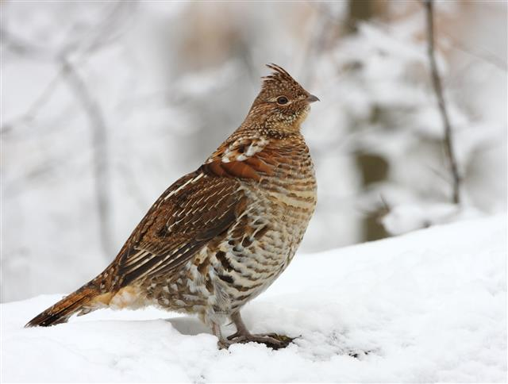
Small Game
Ruffed grouse
Photo courtesy of: Jacob Dingel
50

Slide 24
Category 3: Waterfowl & Migratory Game Birds

Slide 25
Waterfowl & Migratory Game Birds
What common, Pennsylvania goose makes a honking sound?
10

Slide 26
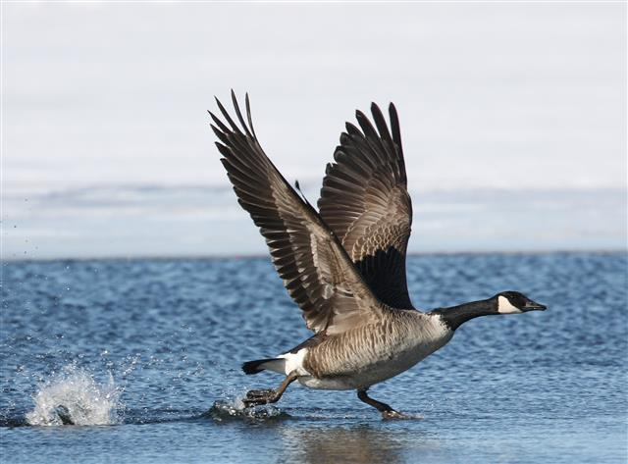
Waterfowl & Migratory Game Birds
Canada goose
Photo courtesy of: Jacob Dingel
10

Slide 27
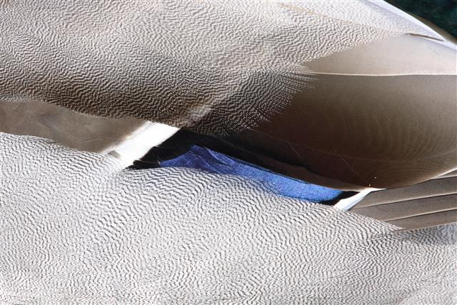
Waterfowl & Migratory Game Birds
Who am I?
Photo courtesy of: Jacob Dingel (cropped)
20

Slide 28
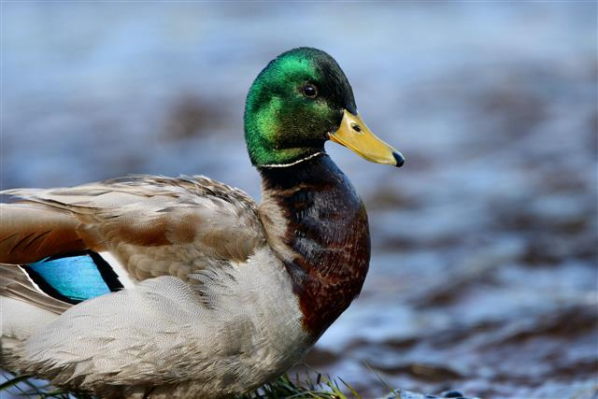
Waterfowl & Migratory Game Birds
Mallard
Photo courtesy of: Jacob Dingel
20

Slide 29
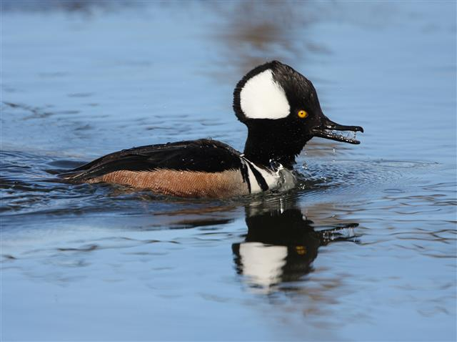
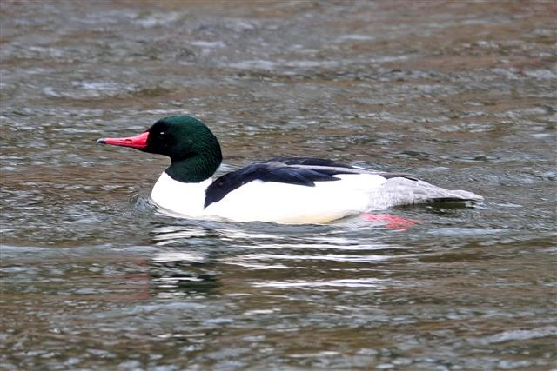
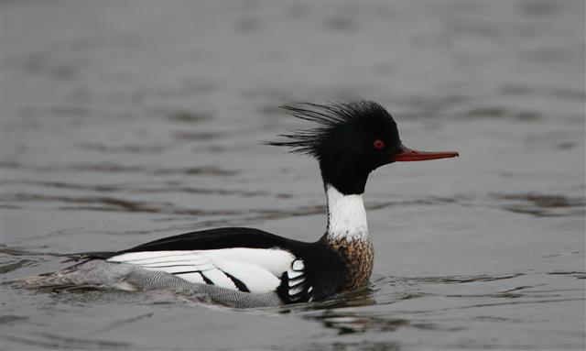
Waterfowl & Migratory Game Birds
Hooded Merganser
Common Merganser
Of these three merganser species that breed in Pennsylvania, which one spends the winter in Pennsylvania?
Photo courtesy of: Jacob Dingel
Red-breasted Merganser
Photo courtesy of: Jacob Dingel
Photo courtesy of: Jacob Dingel
30

Slide 30
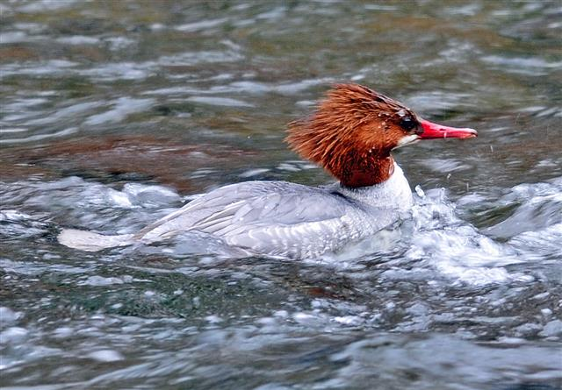
Waterfowl & Migratory Game Birds
Common merganser
Photo courtesy of: Jacob Dingel
Photo courtesy of: Jacob Dingel
30

Slide 31
Waterfowl & Migratory Game Birds
During the mating season, what male bird makes a “Peent” sound from the ground?
40

Slide 32
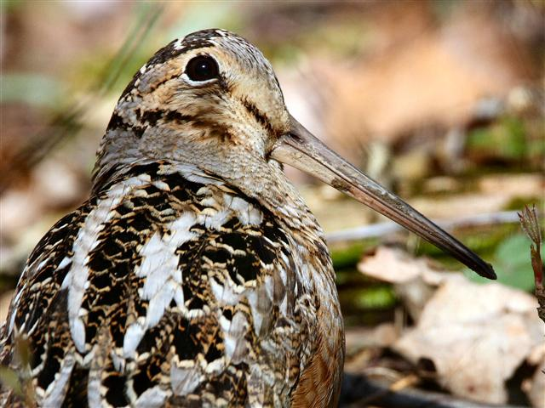
Waterfowl & Migratory Game Birds
American woodcock. It is also known as the
timberdoodle, night partridge, big-eye, bogsucker, and mudsnipe.
Photo courtesy of: Jacob Dingel
40

Slide 33
Waterfowl & Migratory Game Birds
Photo courtesy of: the Pennsylvania Game Commission’s Hunting & Trapping Digest
Which swan Is not native to Pennsylvania, and, therefore, not protected under state or federal law?
50

Slide 34
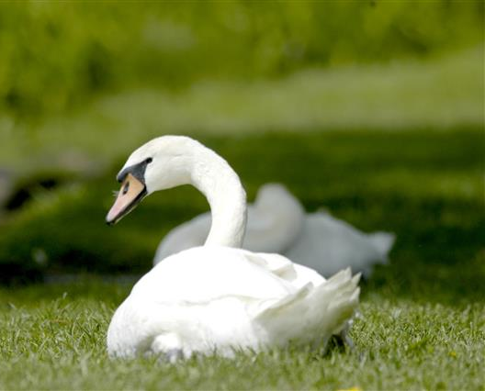
Waterfowl & Migratory Game Birds
Mute swan
Photo courtesy of: Joe Kosack
50

Slide 35
Category 4: Furbearers

Slide 36
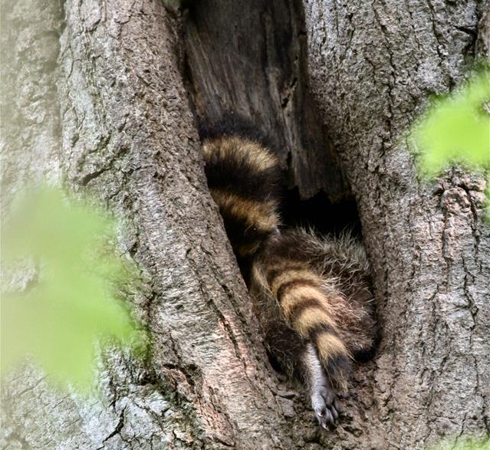
Furbearers
My bushy tail is marked with alternating rings of light and dark fur.
Who am I?
Photo courtesy of: Jacob Dingel
10

Slide 37
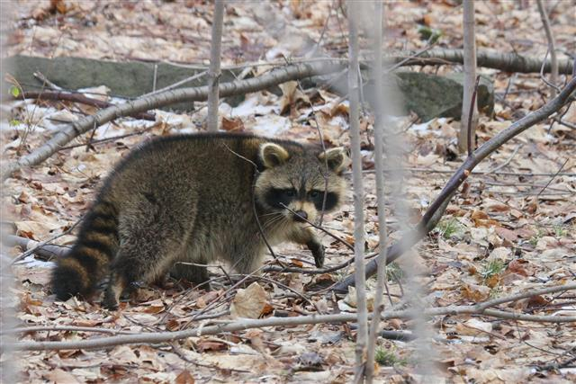
Furbearers
Raccoon
Photo courtesy of: Jacob Dingel
10

Slide 38
Furbearers
I am a member of the canine family. I have a long, bushy, white-tipped tail.
Who am I?
Photo courtesy of: Jacob Dingel
20

Slide 39
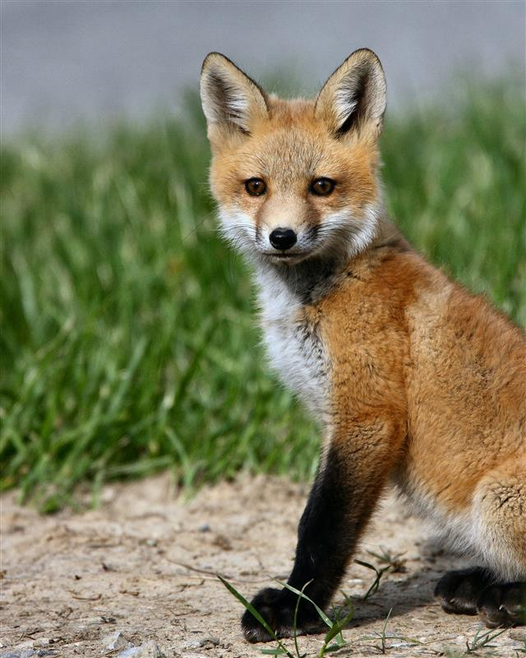
Furbearers
Red fox
Photo courtesy of: Jacob Dingel
20

Slide 40
Furbearers
I am North America’s
only marsupial.
Who am I?
Photo courtesy of: Jacob Dingel
30

Slide 41
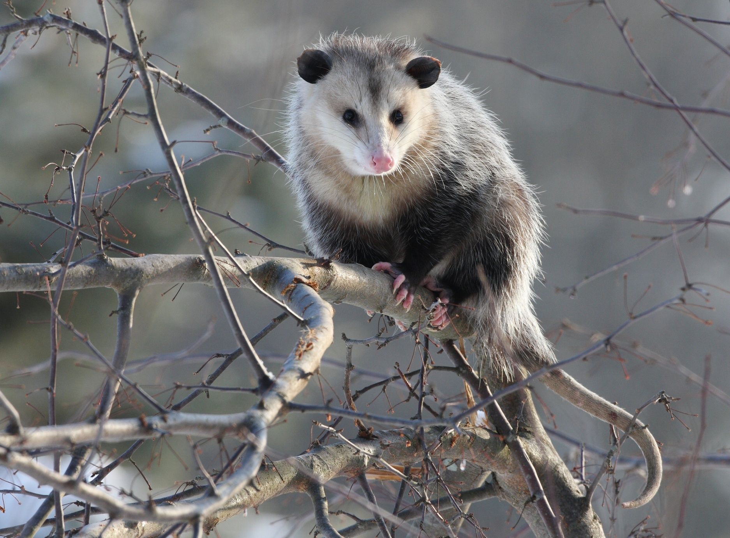
Furbearers
Opossum
Photo courtesy of: Jacob Dingel
30

Slide 42
Furbearers
I am the second largest member of the weasel family in Pennsylvania.
Who am I?
Photo courtesy of: Hal Korber(cropped)
40

Slide 43
Furbearers
Fisher
Photo courtesy of: Hal Korber
40

Slide 44
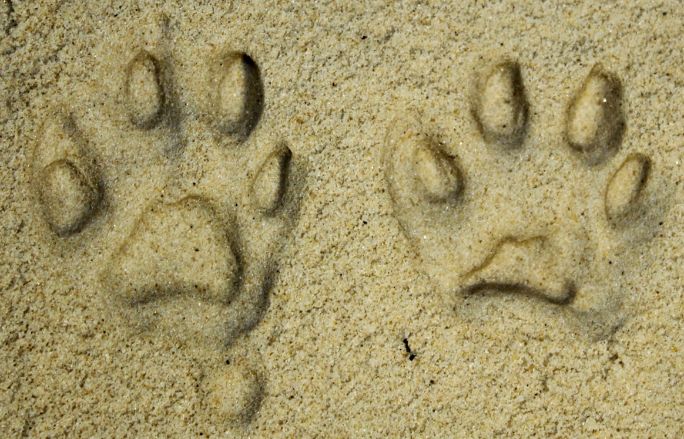
Furbearers
What Pennsylvania furbearer left these tracks behind?
Photo courtesy of: Mandy Marconi
50

Slide 45
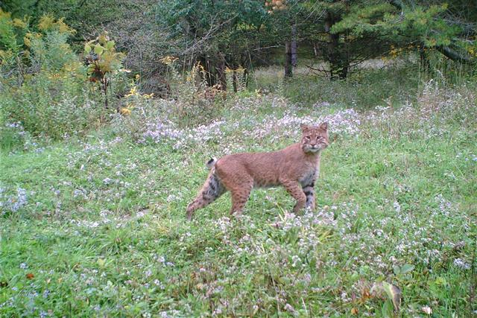
Furbearers
Bobcat
Photo courtesy of: Mark Herring
50

Slide 46
Category 5: State Game Lands

Slide 47
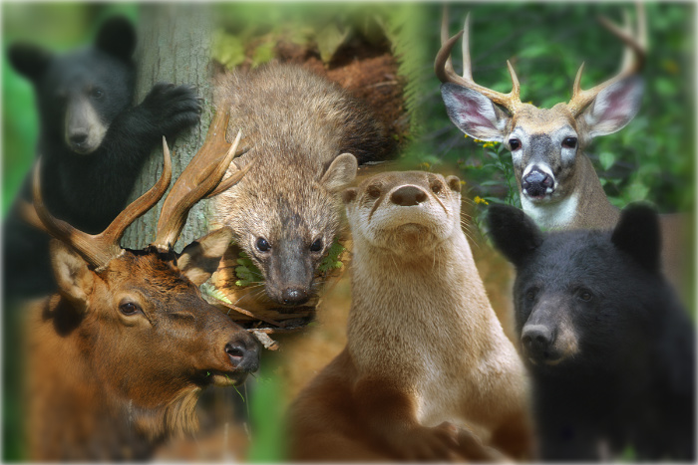
State Game Lands
About how many acres of State Game Lands does the Game Commission own and manage for wildlife and recreation?
160,000 acres
1,600 acres
1.6 million acres
Photo courtesy of: Hal Korber
10

Slide 48
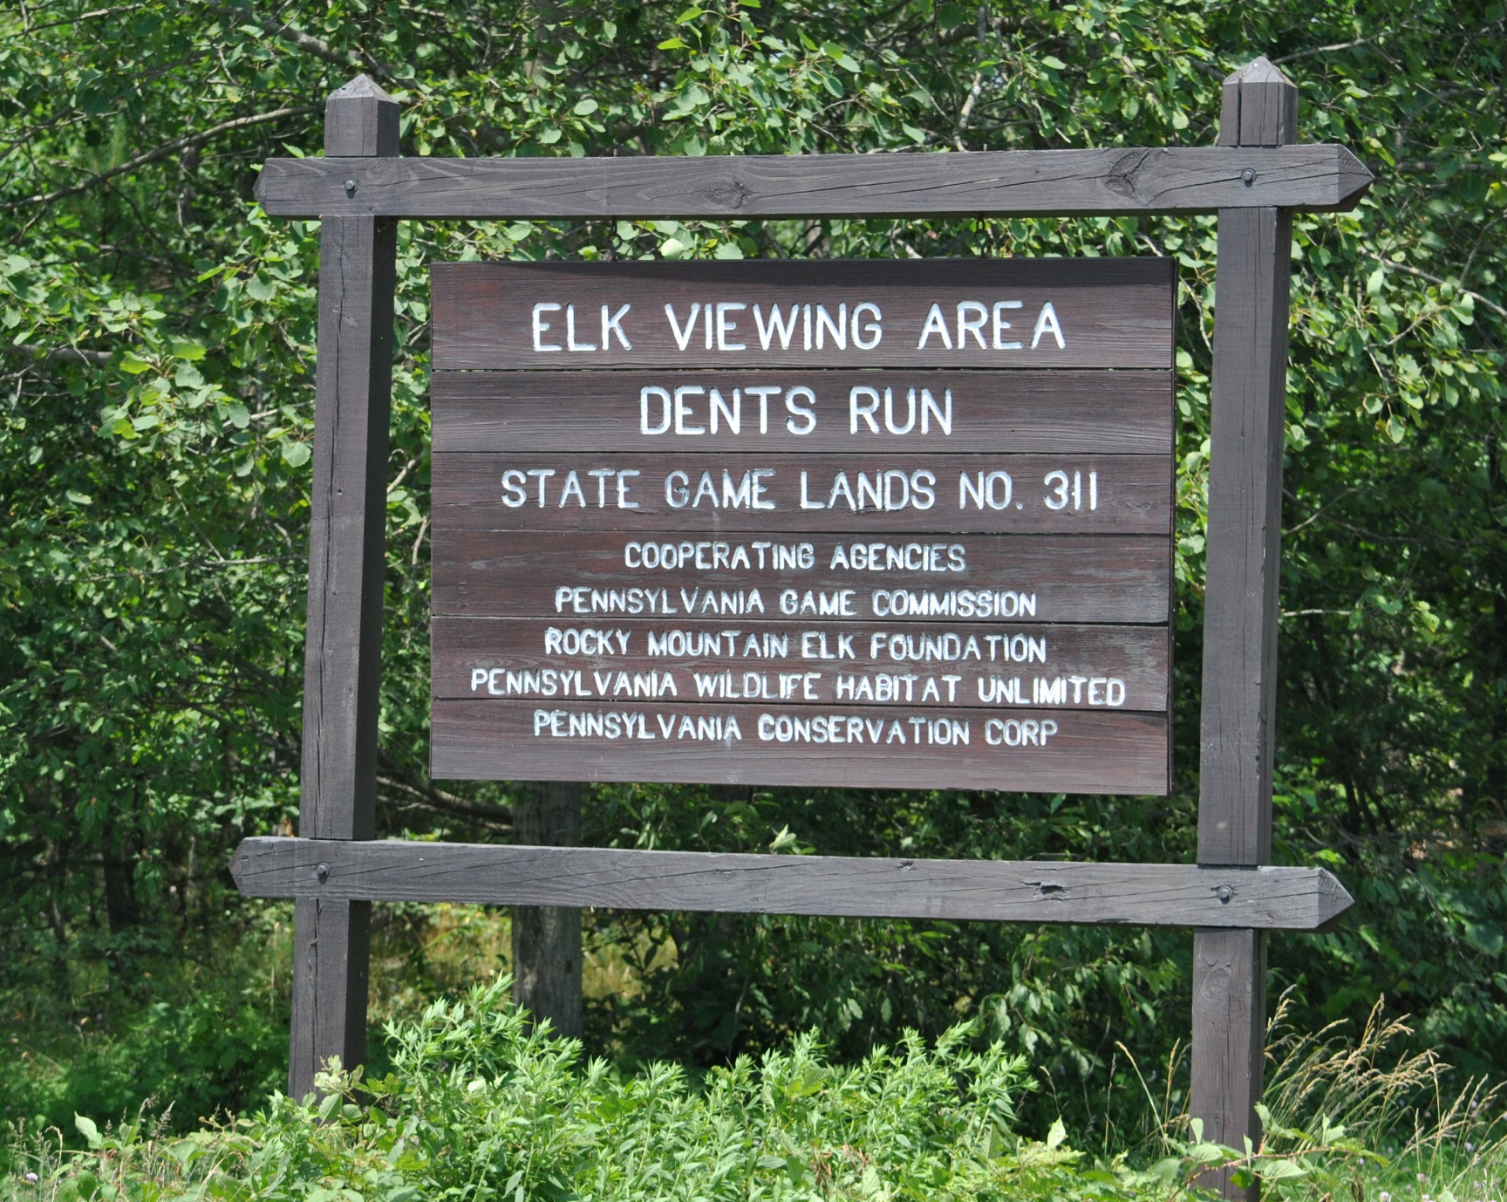
State Game Lands
C. 1.6 million acres
10

Slide 49
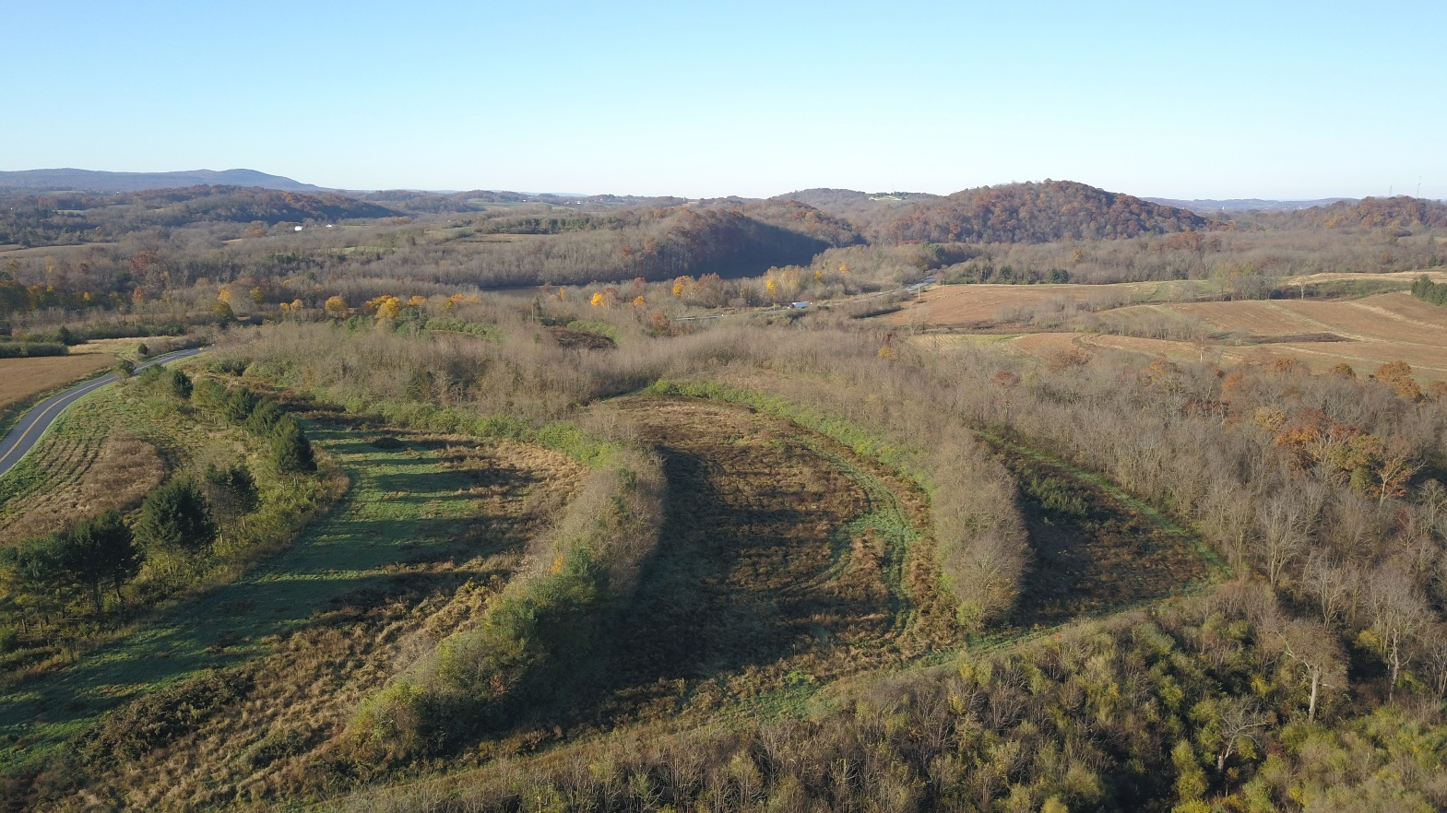
State Game Lands
State Game Lands are
acquired primarily by:
State tax dollars
Game funds
Hunting clubs
Photo courtesy of: Hal Korber
20

Slide 50
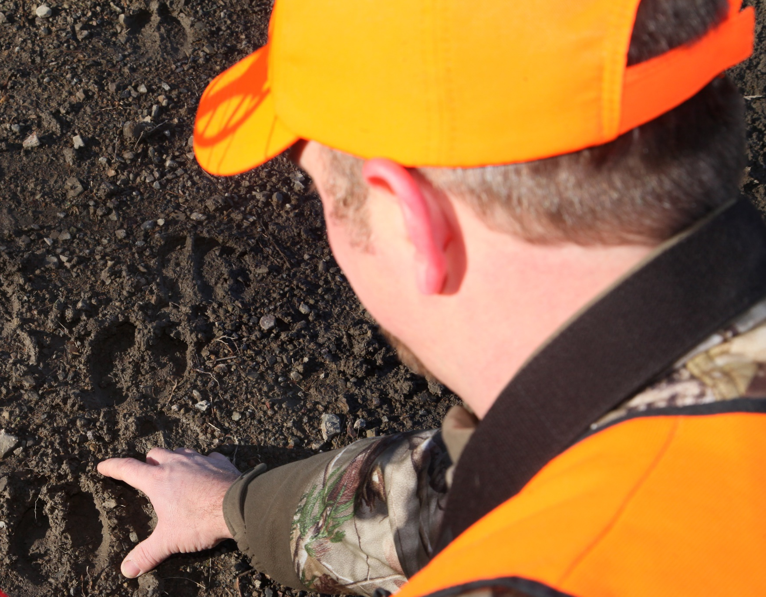
State Game Lands
B. Game funds
All hunting licenses fees go directly to the Game Fund
Photo courtesy of: Hal Korber (cropped)
20

Slide 51
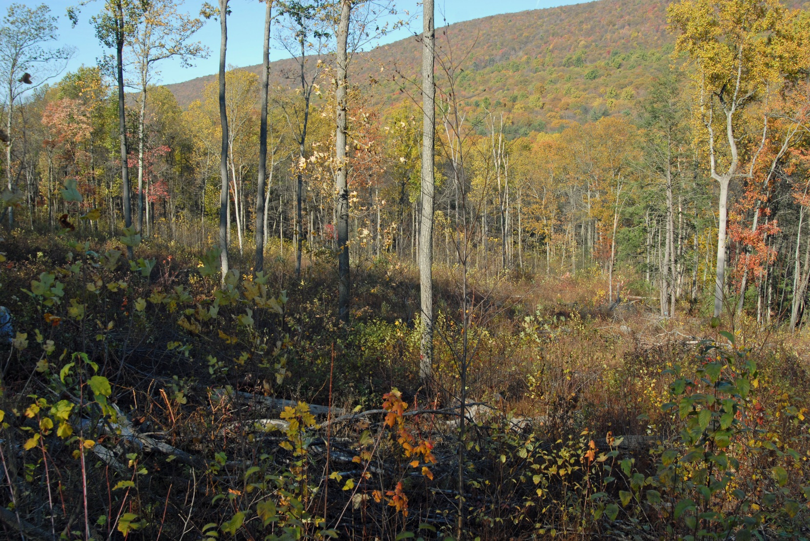
State Game Lands
True or False:
Over 90% of State Game Lands are forested?
Photo courtesy of: Joe Kosack
30

Slide 52
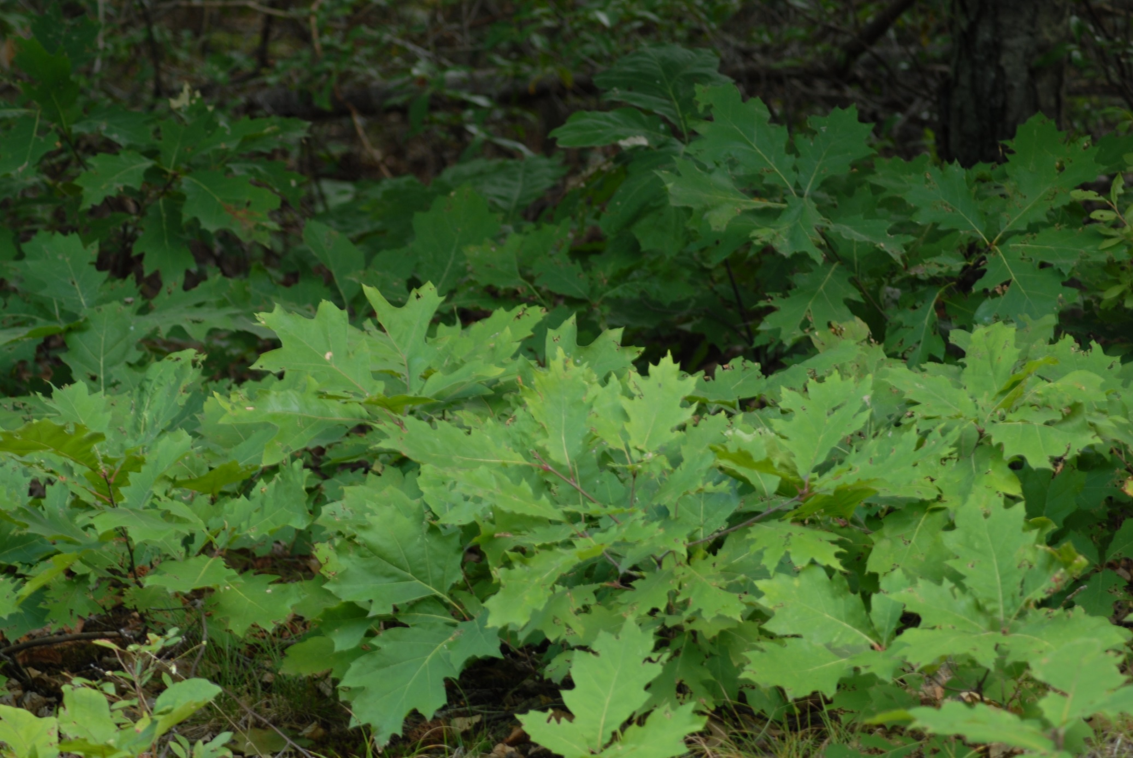
State Game Lands
True
Photo courtesy of: Joe Kosack
30

Slide 53
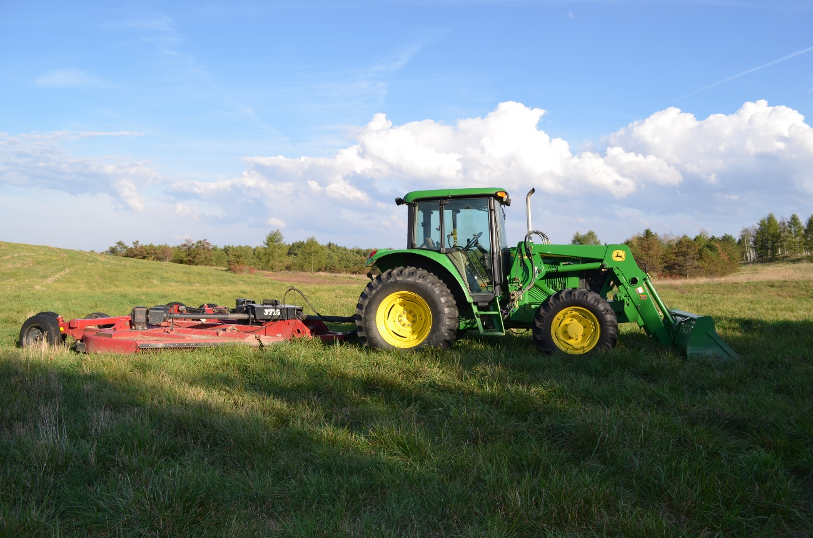
State Game Lands
The people who perform habitat work on State Game Lands are part of a group called:
Wildlife Workers Corps.
Habitat Maintenance Crews.
Habitat Corps.
40

Slide 54
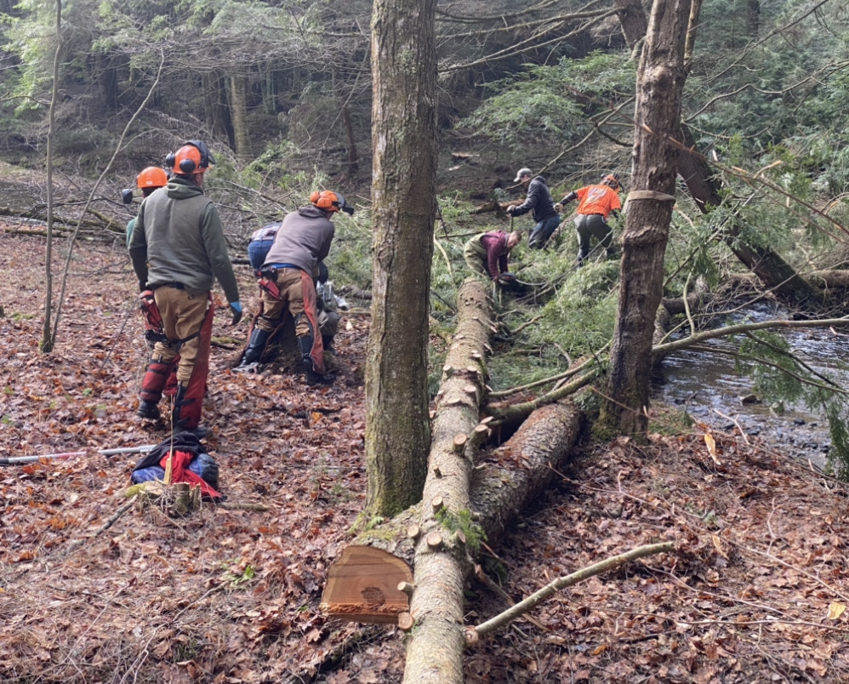
State Game Lands
B. Habitat Maintenance Crews.
Photo courtesy of: Mandy Marconi
40

Slide 55
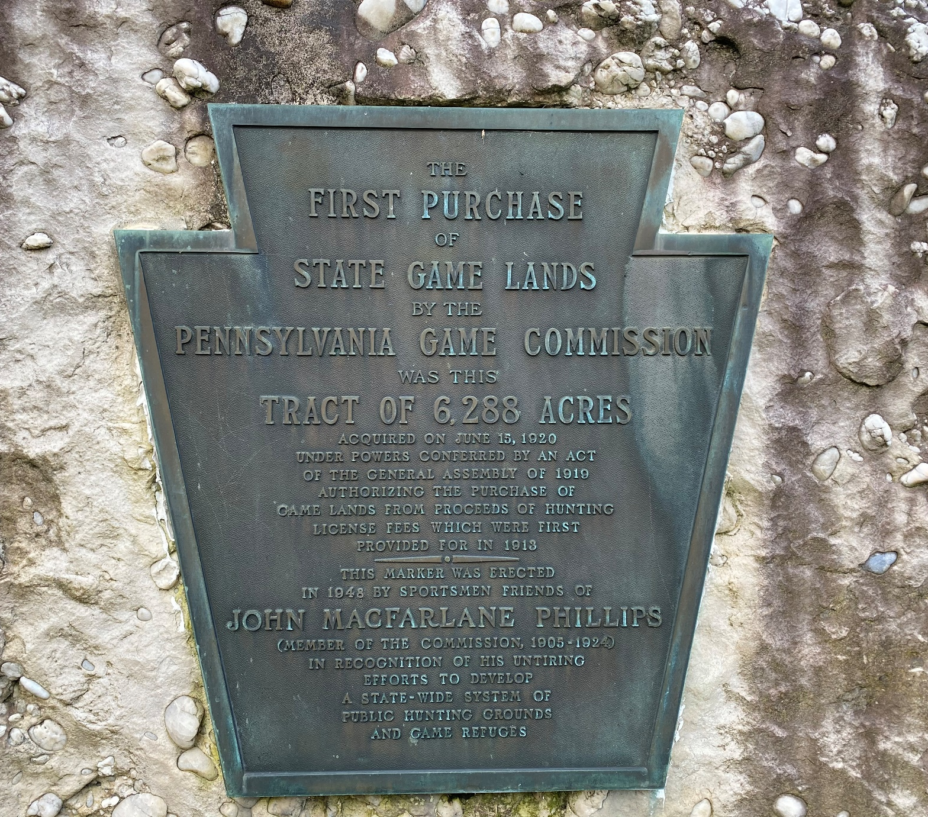
State Game Lands
In 1920, the first State Game Land was purchased. In what county can the first State Game Land be found?
Photo courtesy of: Mandy Marconi
50

Slide 56
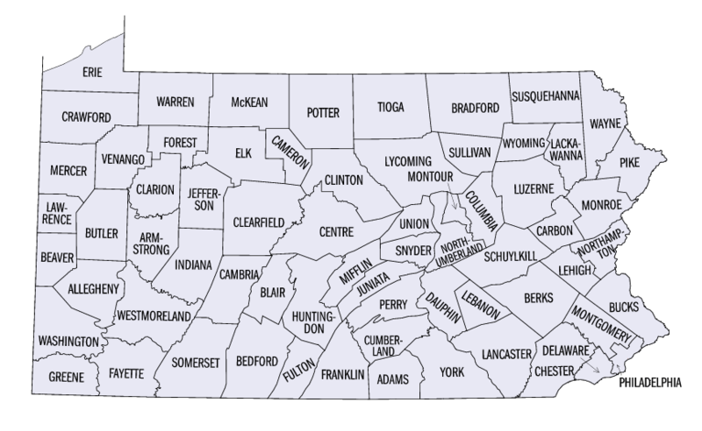
State Game Lands
Elk County, State Game Land 25
FedStats / Public domain
50

