Slide 1
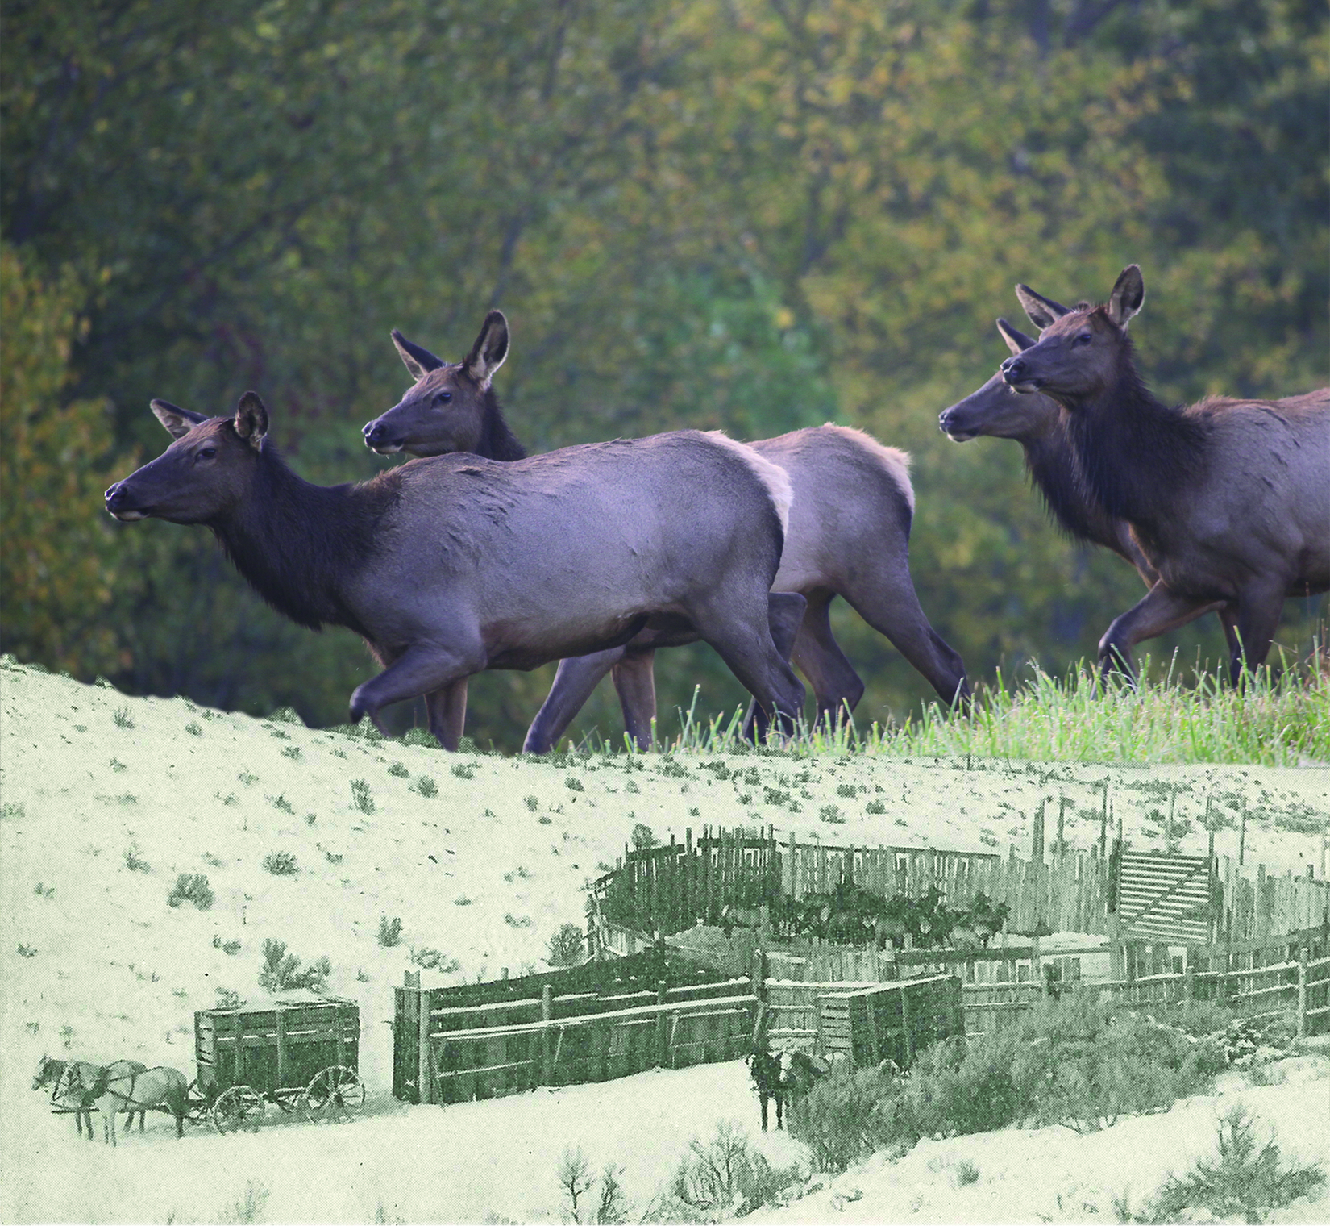
Pennsylvania Elk
Notes:
During this presentation, you will learn about the physical features, lifecycle, habitat and management of Pennsylvania elk.

Slide 2
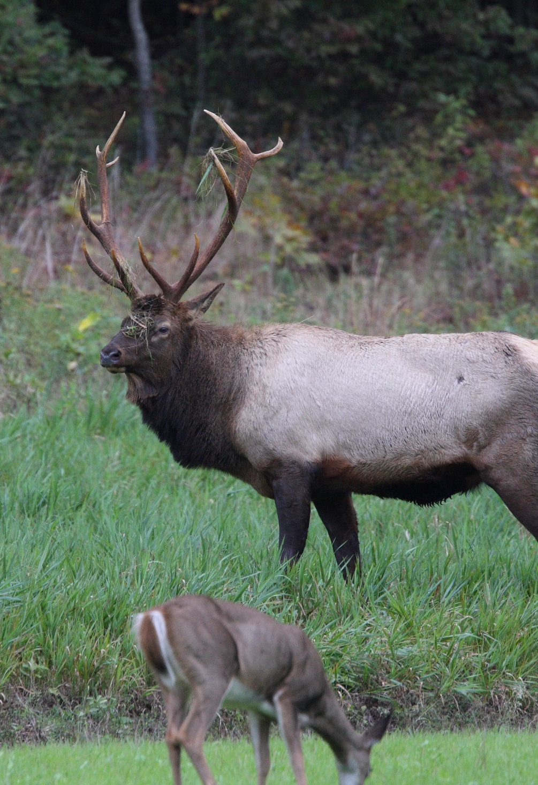
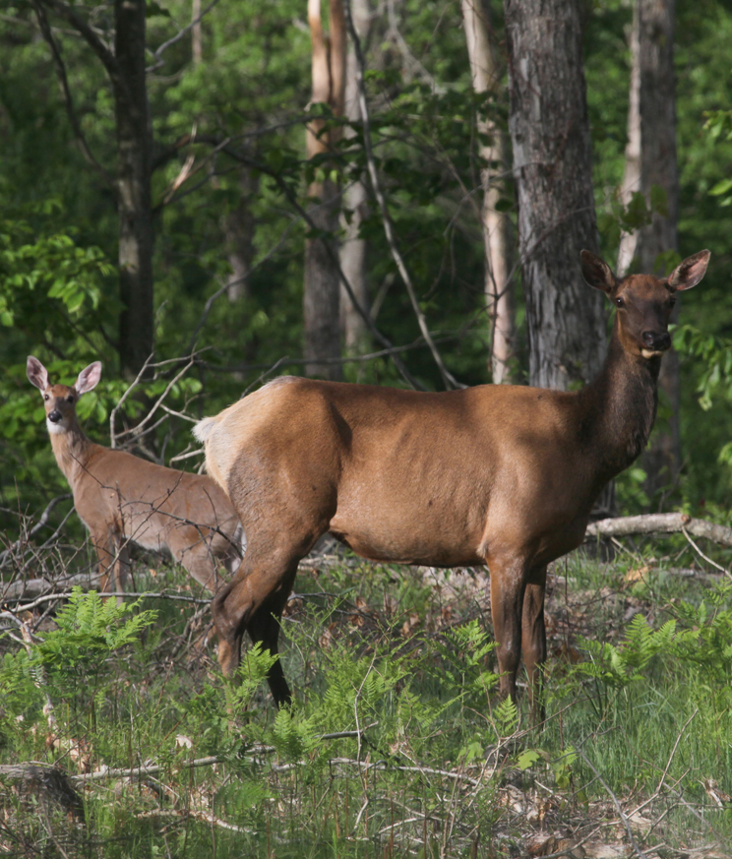
Member of the Deer Family
PGC Photo/ Hal Korber
PGC Photo/ Jacob Dingel
Notes:
Elk are the second largest member of the Cervidae (deer) family in North America and the largest mammal that lives in Pennsylvania. The deer family includes moose, elk, caribou, mule deer, and white-tailed deer. Only elk and white-tailed deer live in Pennsylvania. ¹

Slide 3
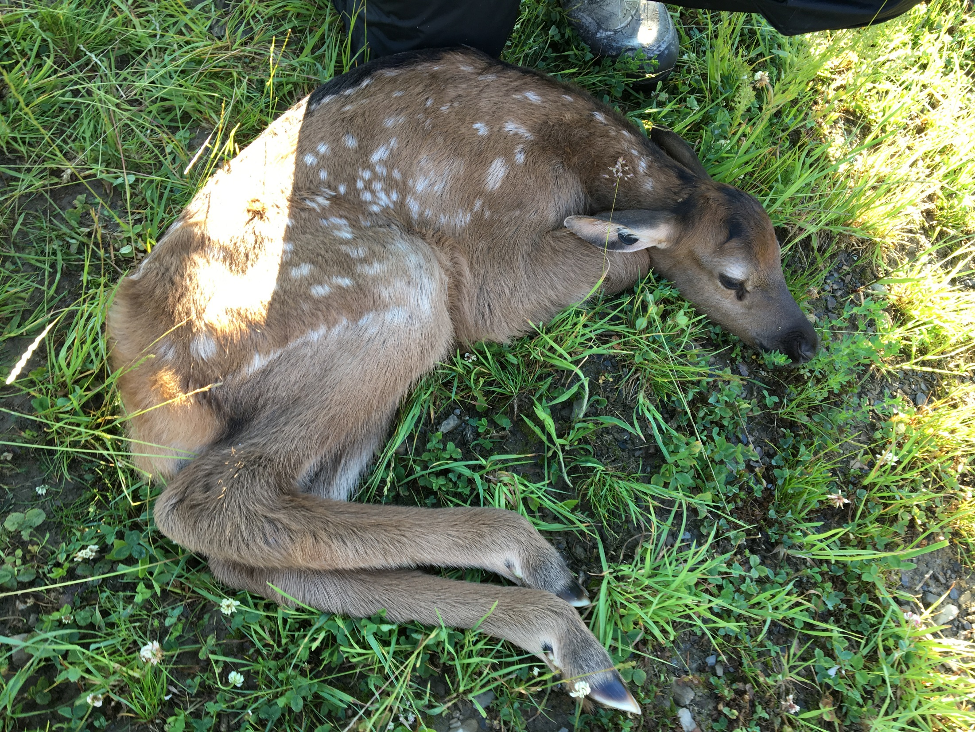
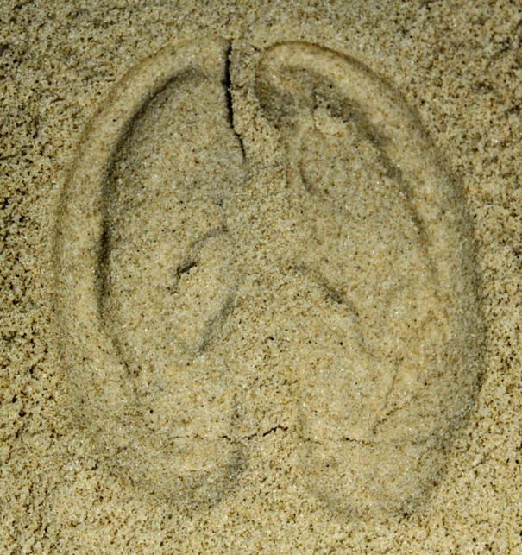
Ungulates
PGC Photo/Mandy Marconi
Notes:
Elk are part of a larger group of animals called ungulates. Ungulates are mammals with hooves. Looking at an elk foot, you will see that elk have four toes. The two toes in the front make up the hoof and two toes in the back are called dew claws. The dew claws provide support and balance. ⁵ The length of an elk track is about 4 inches. ⁸

Slide 4
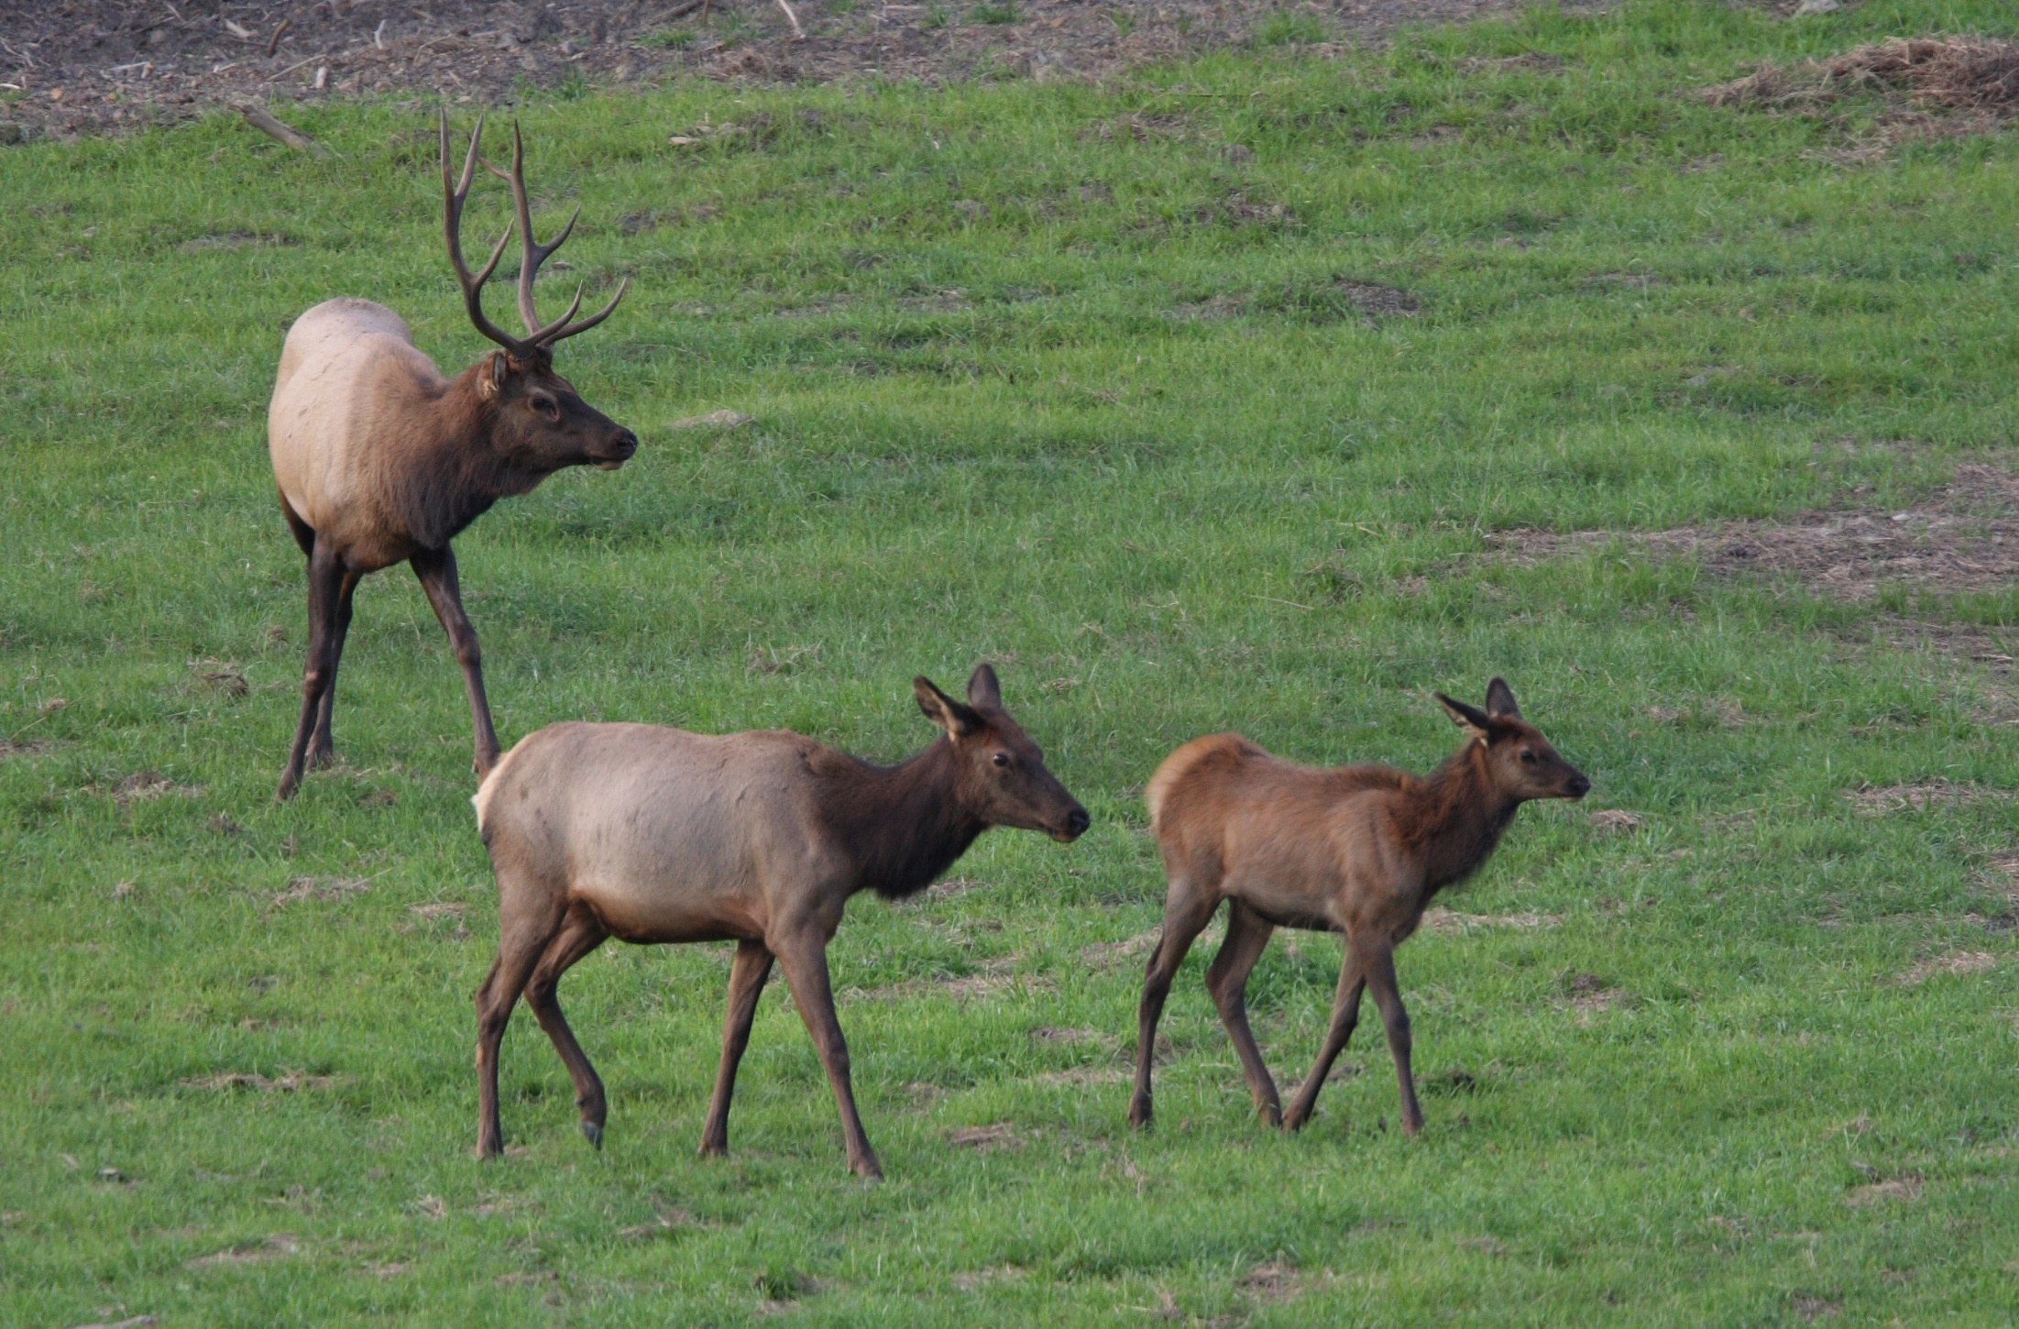
Physical Features
PGC Photo/Jacob Dingel
Notes:
A mature male elk, called a bull, weighs between 600 to 1000 pounds and stands about five feet at the shoulder. For comparison, the average adult buck (male deer) weighs about 140 pounds and stands less than three feet tall at the shoulder. Bulls grow antlers that sweep up and back from the head. A female, called a cow, weighs between 500 to 600 pounds. Baby elk, called calves, weigh between 35 to 45 pounds at birth. ^{1, 2}

Slide 5
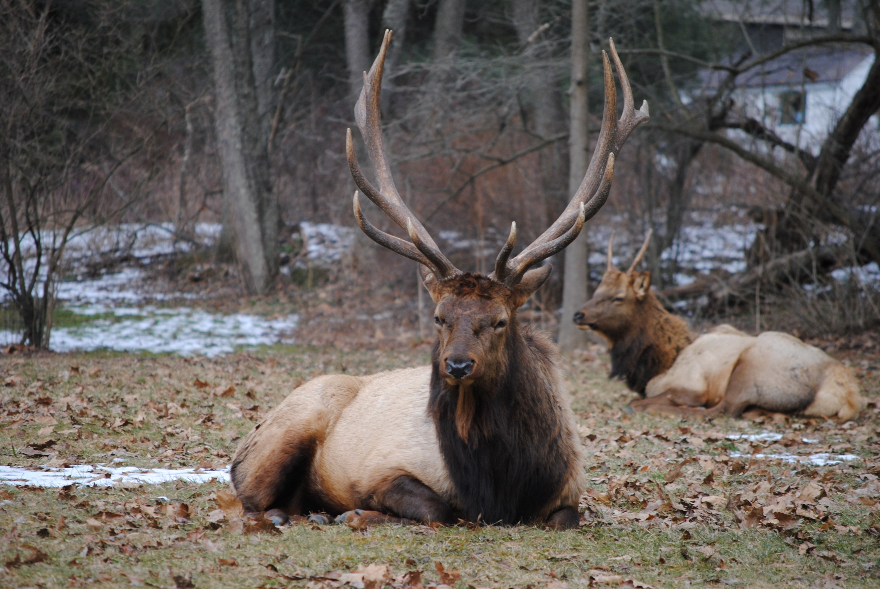
Physical Features
Photo courtesy of: Mandy Marconi
Notes:
Elk eyes are located on the sides of their heads, giving them a larger field of view to see predators. Their ears are large and shaped to allow them to capture and channel sound. Elk fur in the summer is thin and reddish in color. Their fur in winter is brownish in color with their neck, chest, and legs dark brown. Their rump patch is a light beige color year-round. Elk can run up to thirty miles per hour. They jump well and swim often. ^{1, 2}

Slide 6

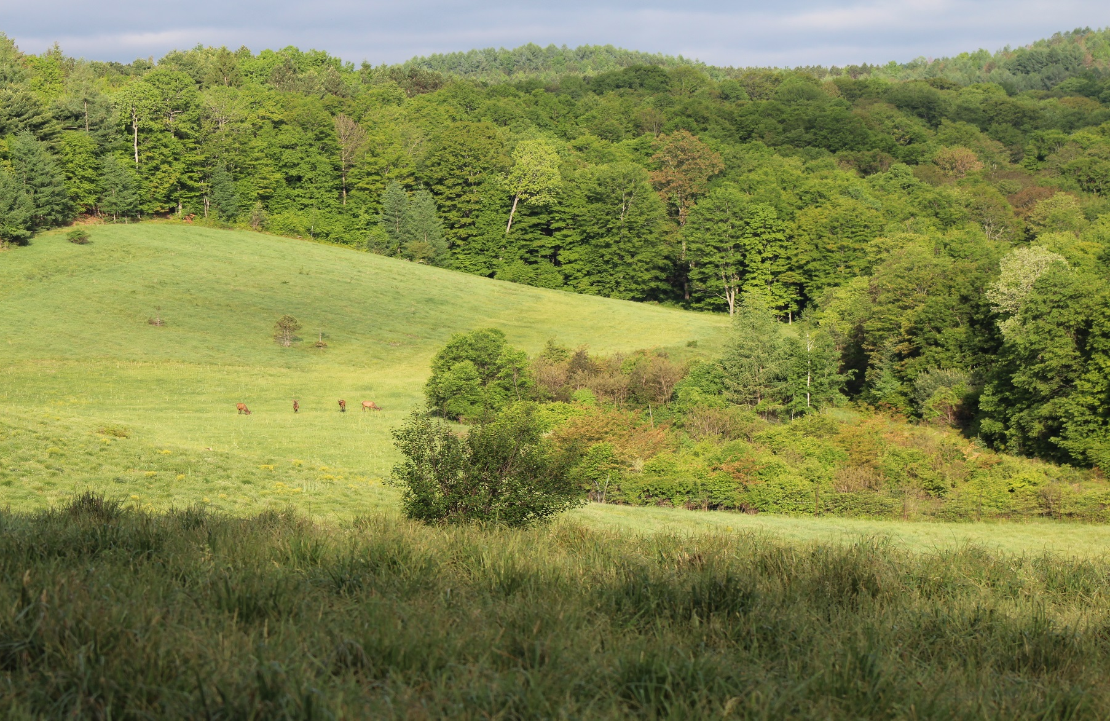
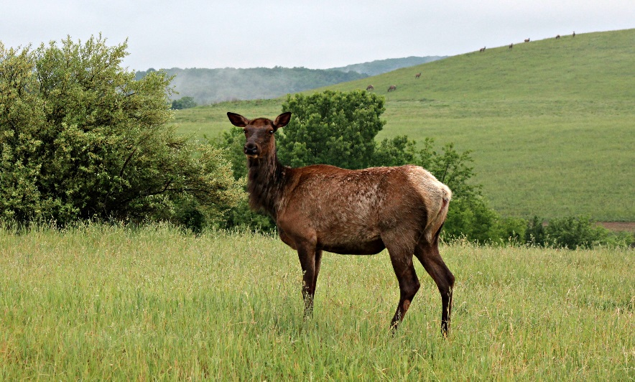
Elk Habitat
PGC Photos/ Mandy Marconi
Notes:
Elk live in several counties of northcentral Pennsylvania including Elk, Cameron, Centre, Clinton, Potter, and Clearfield. Elk need habitat that provides them food, water, shelter and space. Elk habitat in Pennsylvania consists of forests of varying age classes mixed with grassy openings. ¹ Elk need a healthy habitat and are affected by how many people live in and visit their habitat.

Slide 7
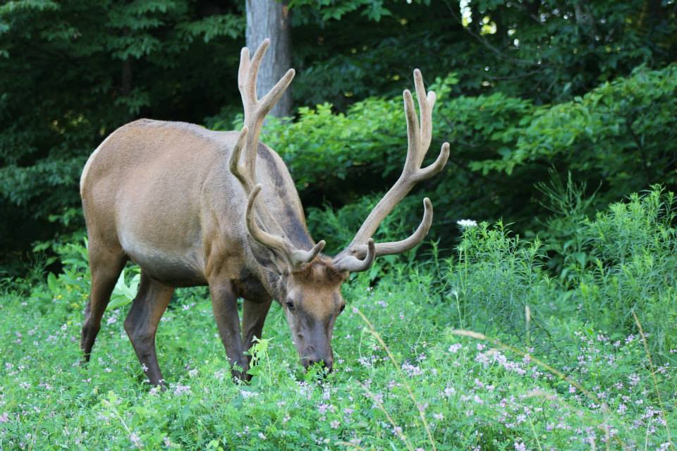
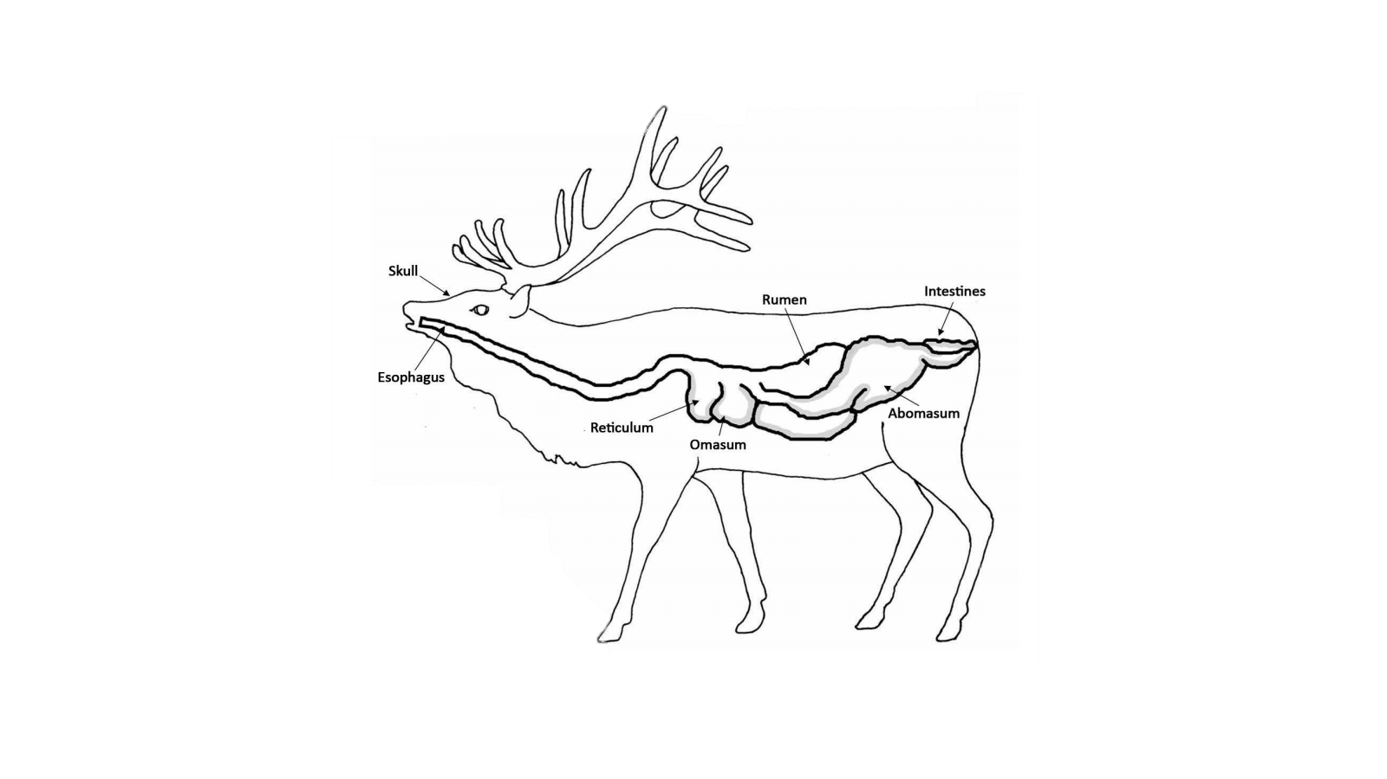
Herbivore
PGC Illustration³
PGC Photo/ Mandy Marconi
Notes:
Elk are the largest herbivore in Pennsylvania. An herbivore is an animal that only eats plants. Elk are primarily grazers, eating mostly grasses and flowering plants. In winter, elk eat more browse (twigs, buds and bark of trees). Elk have a four-chambered stomach, classifying them as a ruminant animal. Their multi-chamber stomach helps them to digest the plants they eat. The first chamber is called the rumen, and it acts as a large storage tank. The rumen allows elk to a large quantity of food at once. When an elk feels safe, it will regurgitate small quantities of food, called cud, to re-chew it and break it down further. This adaptation helps an elk decrease it’s time in open spaces where it has greater exposure to predators. ³

Slide 8
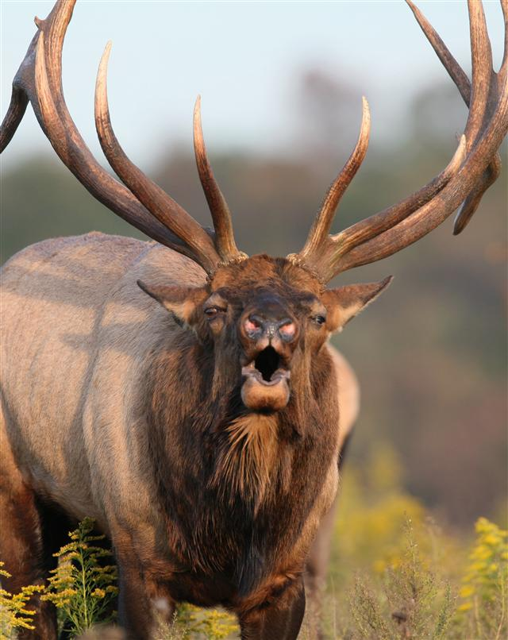
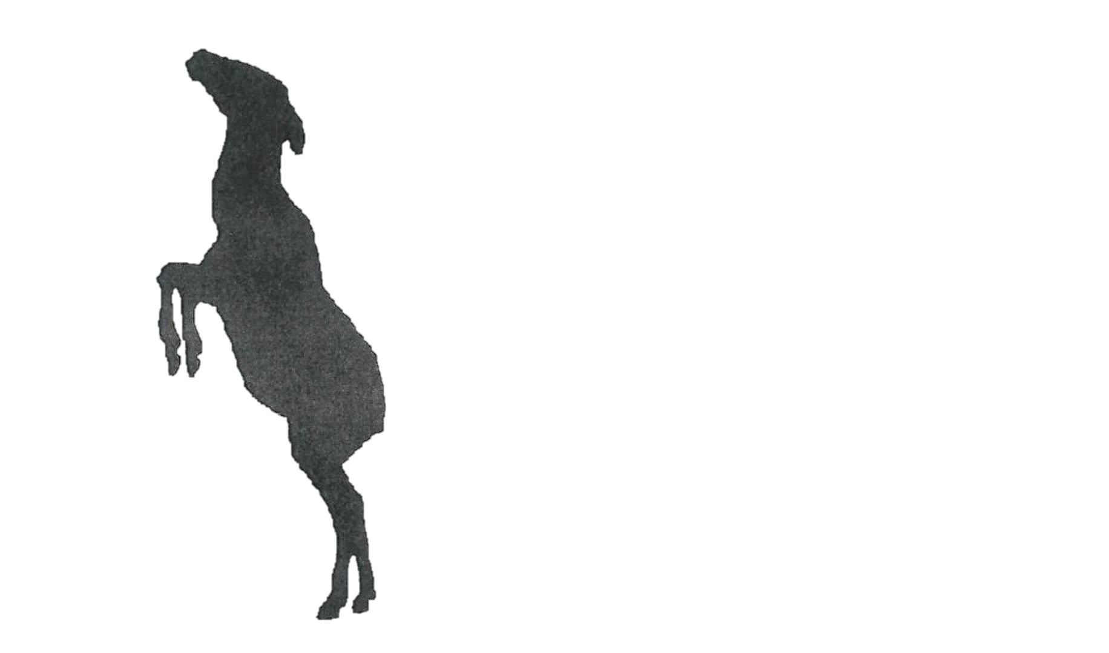
Elk Communication
Submissive
Fighting
Courtship
Threatening
Herding
Alarmed
PGC Photo/ Hal Korber
Notes:
Elk Communicate in a variety of ways from noises to posture. Cows bark to warn of danger, and calves in distress make loud squealing sounds. Chirps and mews are general conversation among the herds, and bulls bugle during the fall. ^{1, 5} In addition to vocalizations, elk use a variety of postures that help them communicate with each other.⁷

Slide 9
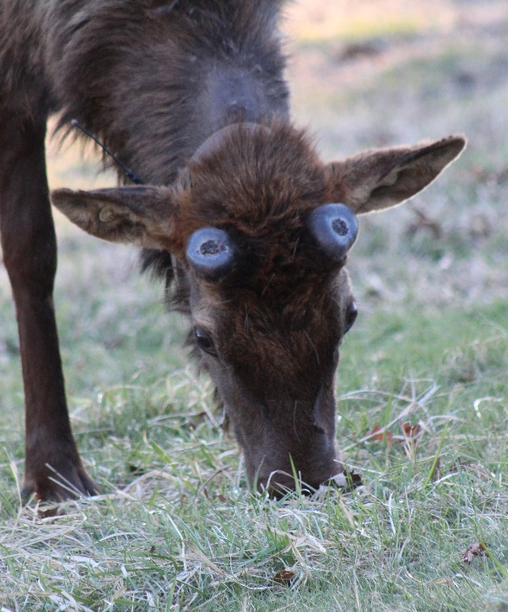
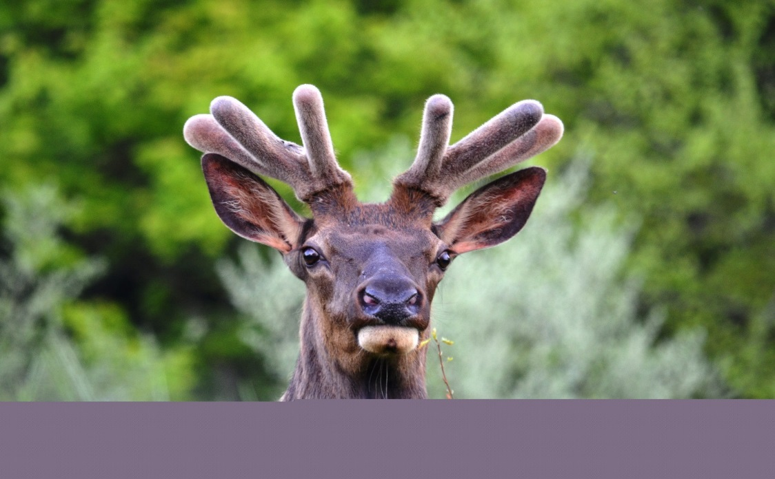
Bulls During Spring and Summer
PGC Photos: Mandy Marconi
Notes:
In spring and summer, bull elk live by themselves or in small groups with other bulls. Elk begin growing antlers in April and May. Antlers begin growing out of two bony bums on an elk’s head called pedicles. Antlers start out as layer upon layer of cartilage. They are tender and easily damaged in this stage. Soft furry skin, called velvet, covers the growing antlers. The velvet contains blood vessels and veins that supply nutrients to the growing bones. Antlers are the fastest growing tissue in any mammal and can grow up to an inch a day. After the antlers fully develop (by August), the blood supply stops flowing to the velvet and it dries up and falls off. Bulls may rub the velvet off on trees and shrubs. Some bulls may grow antlers with main beams 4 to 5 feet in length and having five to nine tines to a side.

Slide 10
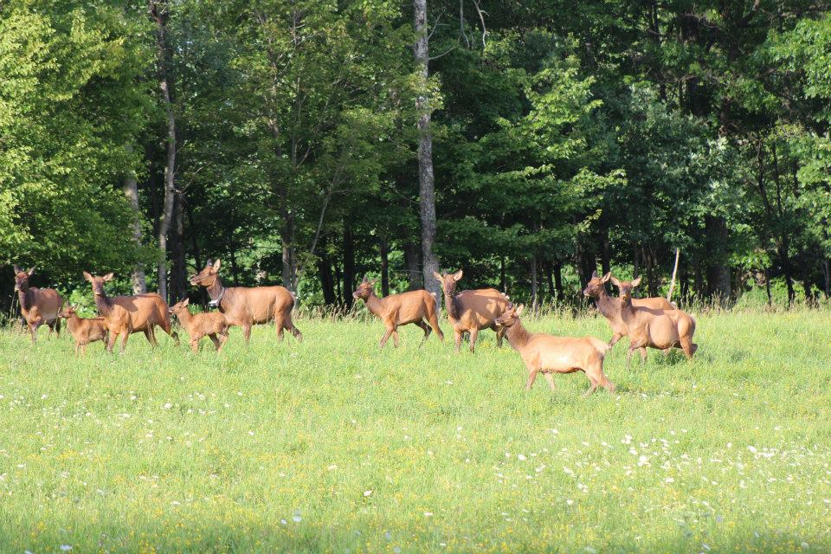
Cows and Calves During Spring and Summer
PGC Photo/ Mandy Marconi
Notes:
During the last week of May and the first two weeks of June, is when most of the elk calves are born in Pennsylvania. Prior to giving birth, cows, will separate from their herds and seek a secluded place to give birth to a single calf. Calves are born virtually scentless and dappled in spots, which helps them camouflage into their surroundings. To avoid attracting predators to her calf, females feed away from her calf and return to nurse it only a few times a day. The calf will lay motionless and quiet to deter any predators from detecting it. This strategy gives the calf its best chance of survival in its first few weeks of life, when it is not strong enough to out run predators or keep up with the herd. Calves can stand when they are only twenty minutes old, and within an hour, they begin to nurse. Calves feed on plants before they are a month old. By July, nursery herds form, which consist of several cows, calves, and yearlings. Within this herd is a lead cow, sometimes called a babysitter cow, that the calves look to for alerts of danger.^{1, 3}

Slide 11
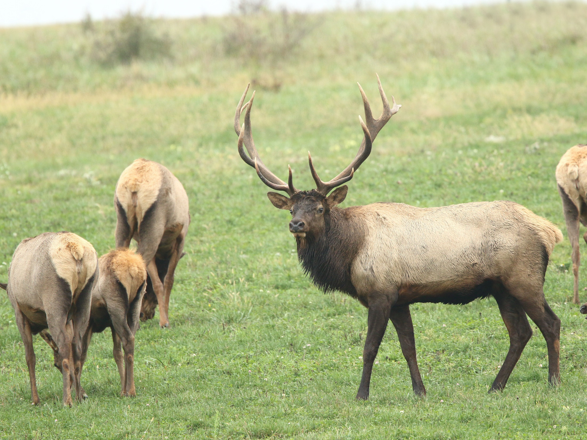
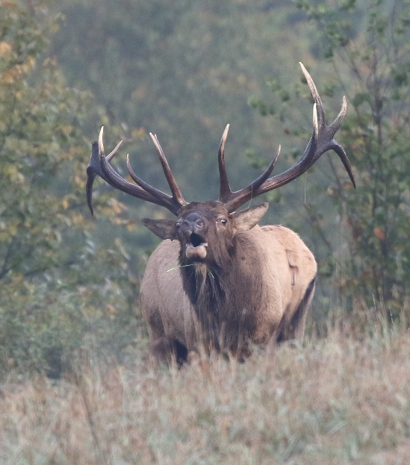
Elk During The Fall
PGC Photos/ Jacob Dingel
Notes:
Elk breed in the fall. The breeding season is called the rut. Elk will bugle to attract cows and to warn away other bulls. A mature bull will form a group of cows and calves called a harem, and he will defend that harem from other bulls. Yearling males are driven from the harem. Another bull, nearly equal in size to the lead bull, may challenge the lead bull to a fight. If a fight begins, the bulls will lock antlers and shove each other to show their strength. The weaker bull will run away. After the rut, the harems will disband and bulls will go off on their own or in small bachelor groups. Both males and females will focus on eating to build up their fat reserves for the winter.^{1,3}

Slide 12
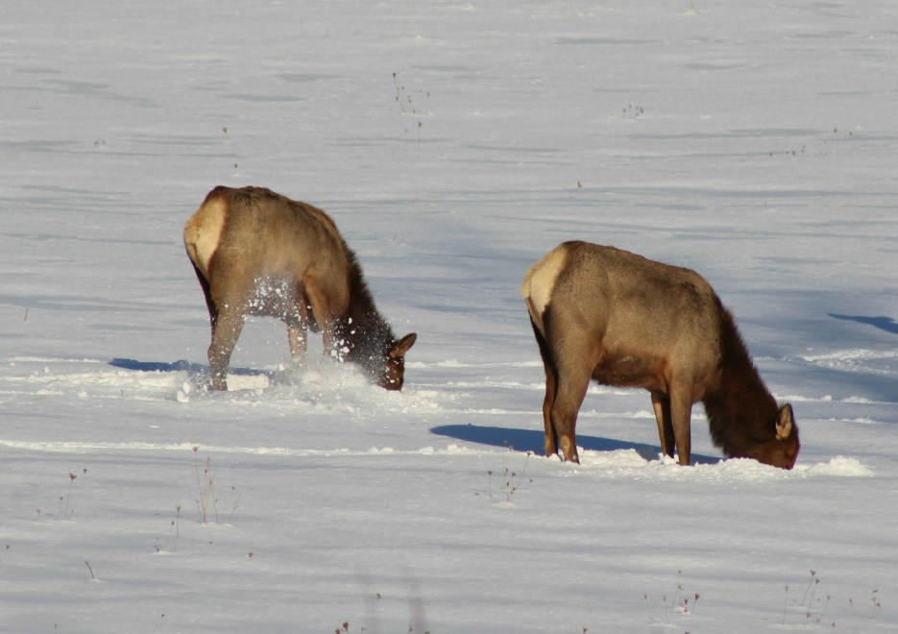
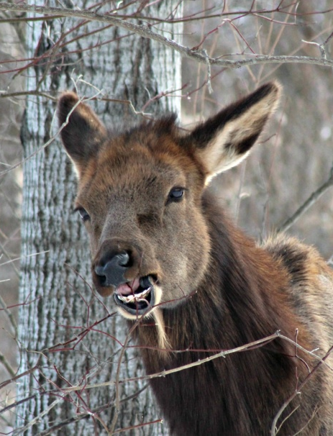
Elk During Winter
PGC Photos/ Mandy Marconi
Notes:
Elk are well adapted to survive the cold winters of Pennsylvania. The winter fur is thicker than their summer fur and consist of two layers-long guard hairs over wooly underfur. Their winter coat keeps them warm and waterproof. They also eat less and spend more time resting to conserve energy. Most elk begin to shed their antlers in late winter, during March. Antler sheds play an important role in the ecosystem. Rodents and other animals gnaw on them for nutrients such as calcium and phosphorus. ³

Slide 13
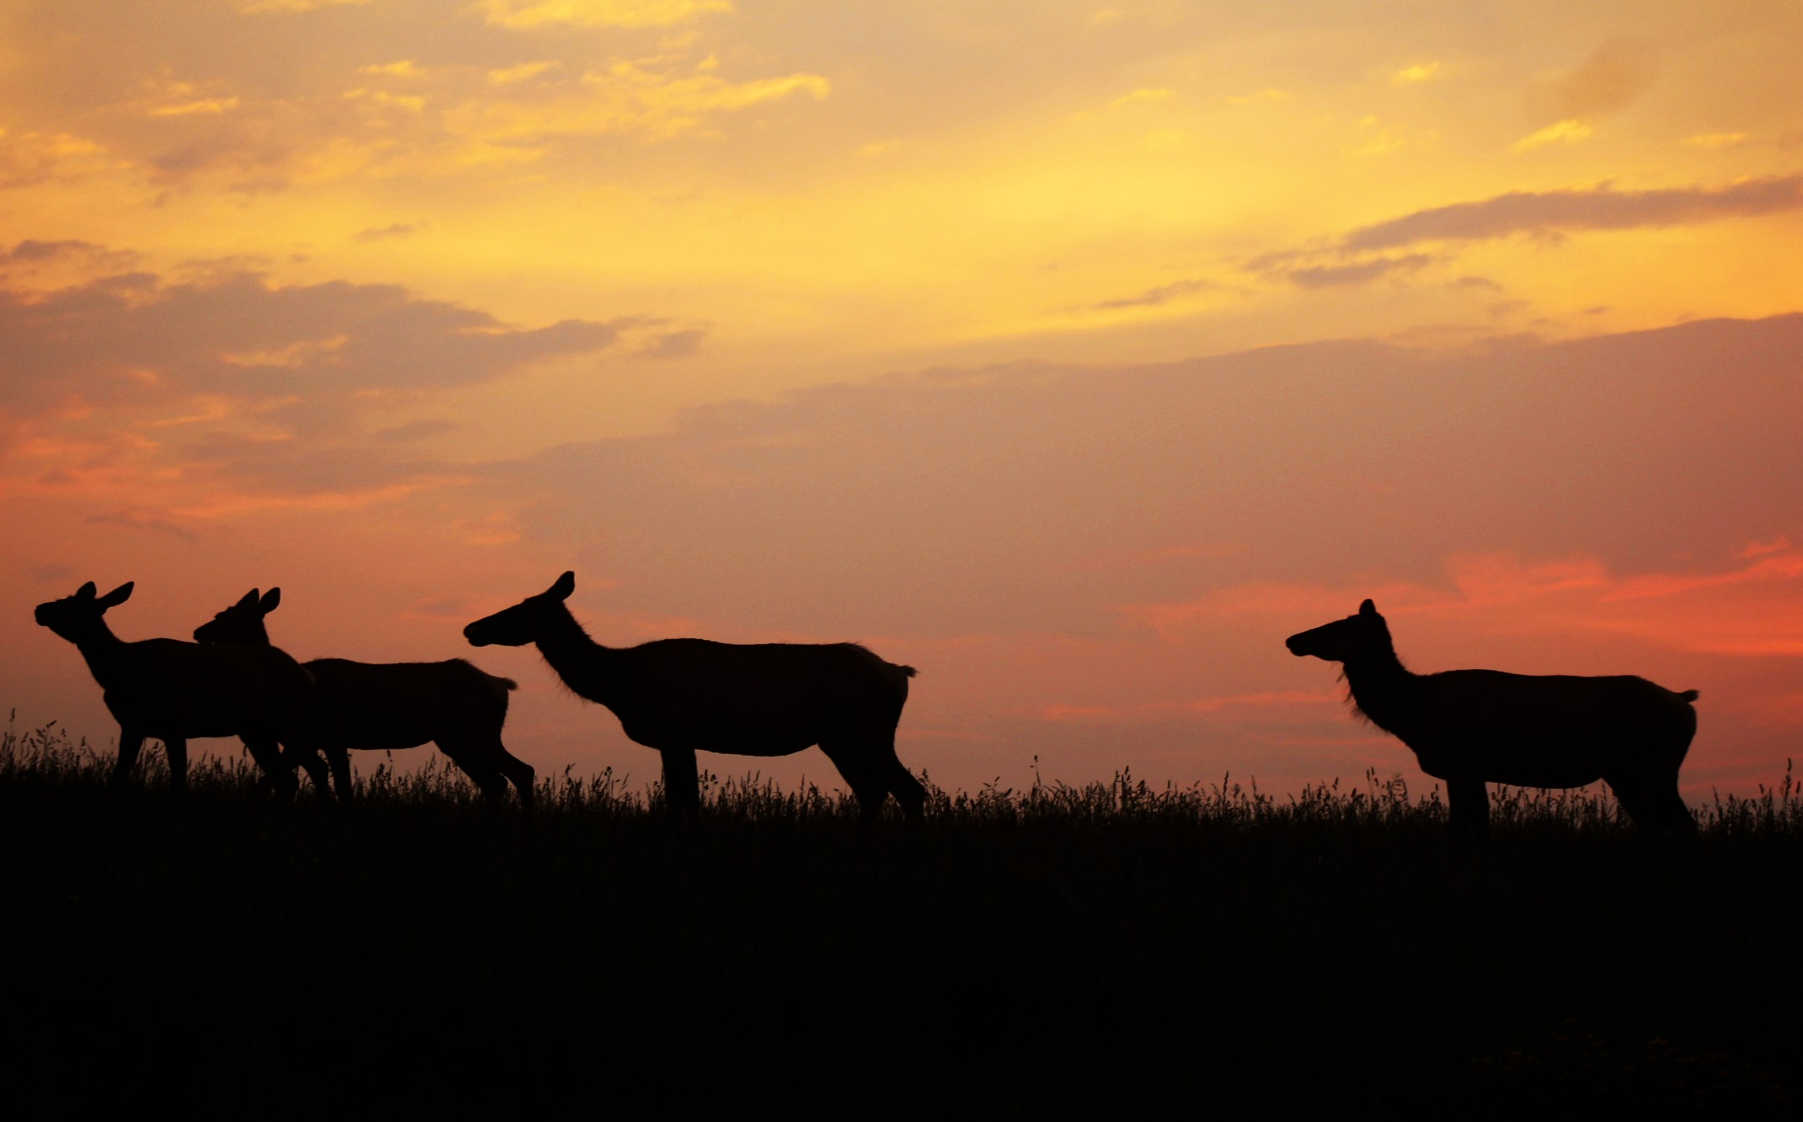
Elk Management
Notes:
Elk are an important natural resource in Pennsylvania. Elk provide recreational opportunities through wildlife watching and lawful hunting. The elk population in Pennsylvania is estimated to be around 1350 elk. The Game Commission’s goal is to manage elk in a manner that ensures a healthy and sustainable elk herd for current and future generations.

Slide 14

The End
Notes:
Sources:
Pennsylvania Game Commission Elk Wildlife Note
Pennsylvania Game Commission White-tailed Deer Wildlife Note
Pennsylvania Game Commission An Educator’s Guide to Celebrating Pennsylvania Bald Eagle and Elk Reintroductions
Project WILD, WILD About Elk Curriculum Guide
RMEF.org/ Elk Facts
Information Source: Horowitz, E. Rocky Mountain Elk Ivory. 2012. Magazine. Montana Fish, Wildlife, and Parks. Retrieved from: http://fwp.mt.gov/mtoutdoors/HTML/articles/2012/ivories.htm#.VdIonPlViko
http://www.agfc.com/education/justForEducators/Pages/lessonPlanDetails.aspx?show=47

