Slide 1
Bear
Management
by the
Pennsylvania Game Commission
Notes:
The Pennsylvania Game Commission manages all of Pennsylvania’s wild birds and mammals, for current and future generations.

Slide 2
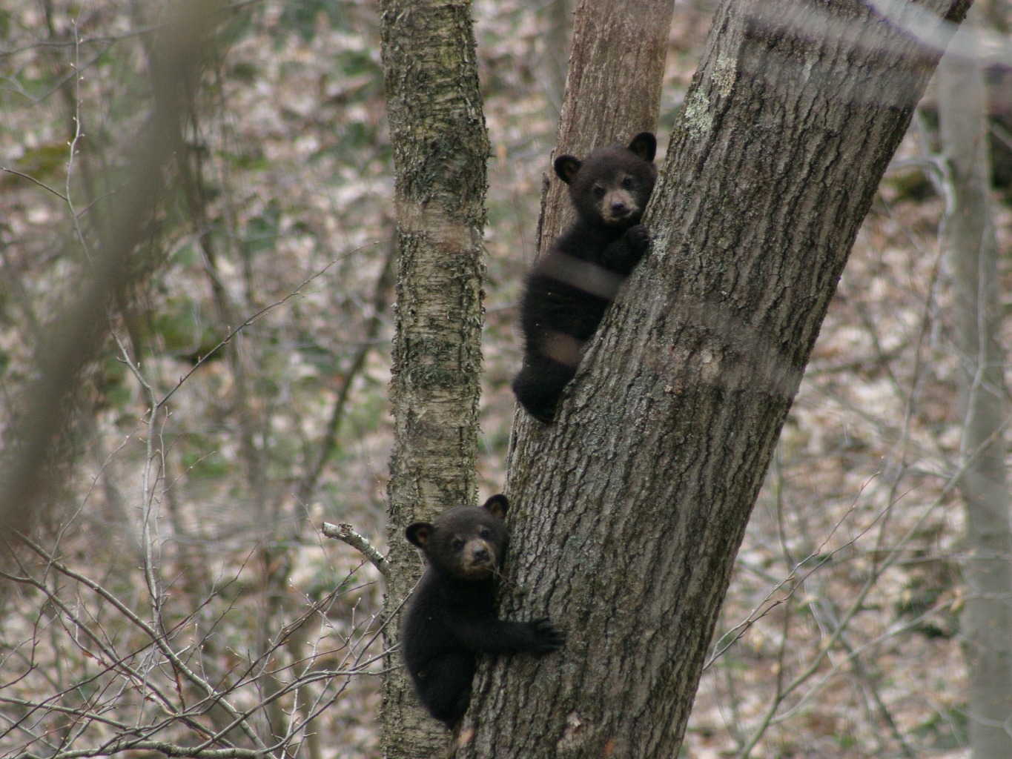
Notes:
Pennsylvania is home to a population of approximately 20,000 black bears. Bears can be found in large forested areas statewide although, they
are not as common in large urban or agricultural areas.

Slide 3
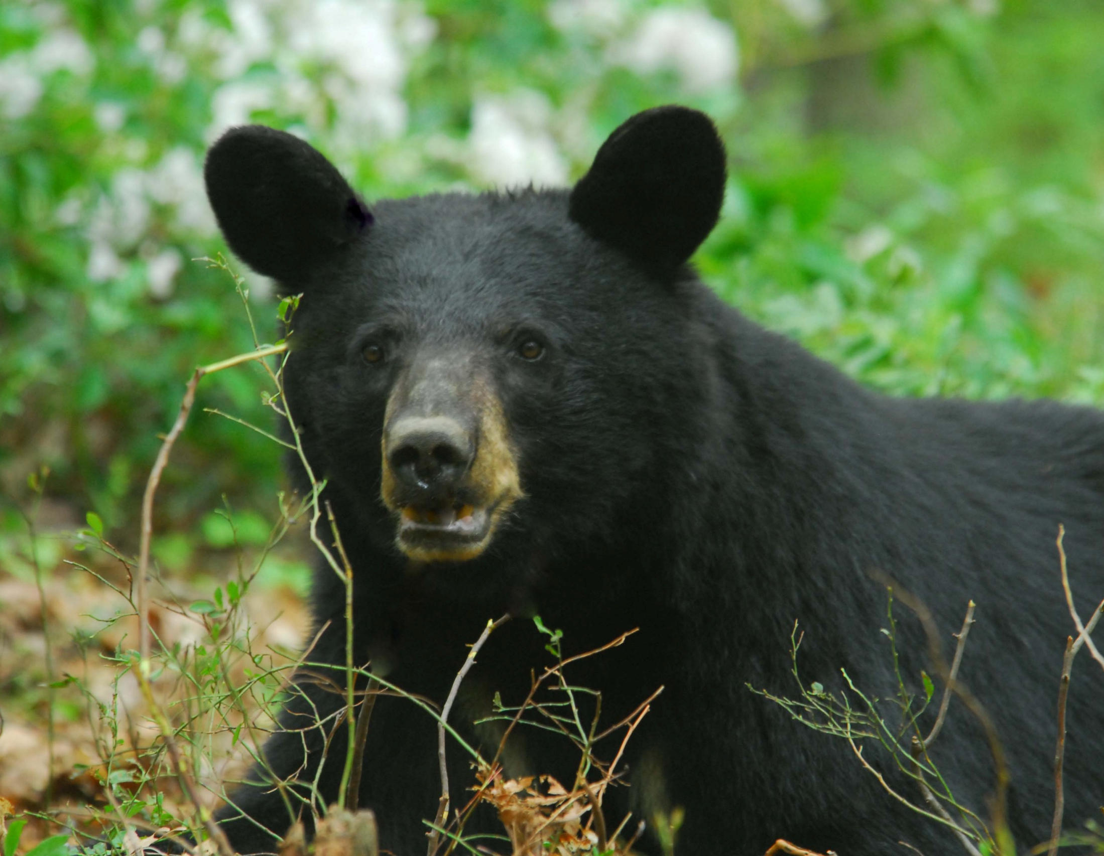
Notes:
Bears are trapped for research or in areas where they have become a nuisance. In PA, we currently trap and tag about 700 bears each year. Typically nuisance bears are moved after capture, while research bears are released on site.

Slide 4
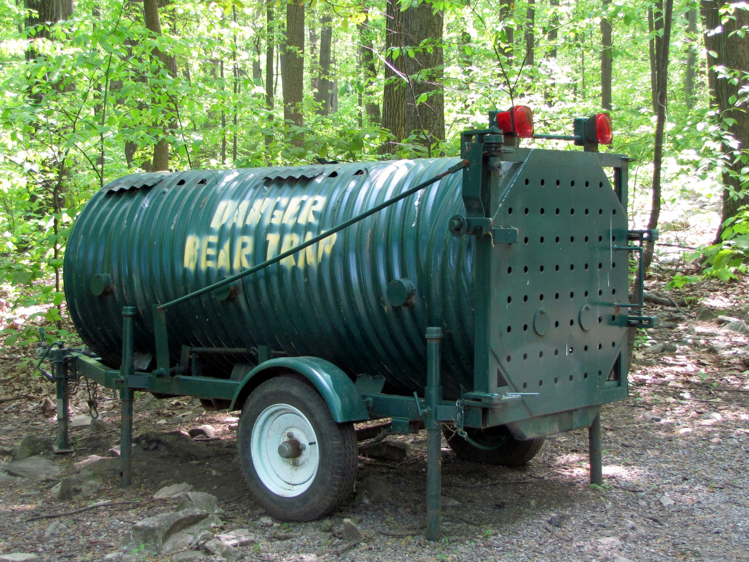
Notes:
Bears are captured in a “culvert” trap. Inside the trap, there is a basket that is filled with bait. Often, traps are baited with donuts. When a bear pulls on the basket, a trigger releases the door and the trap closes.

Slide 5
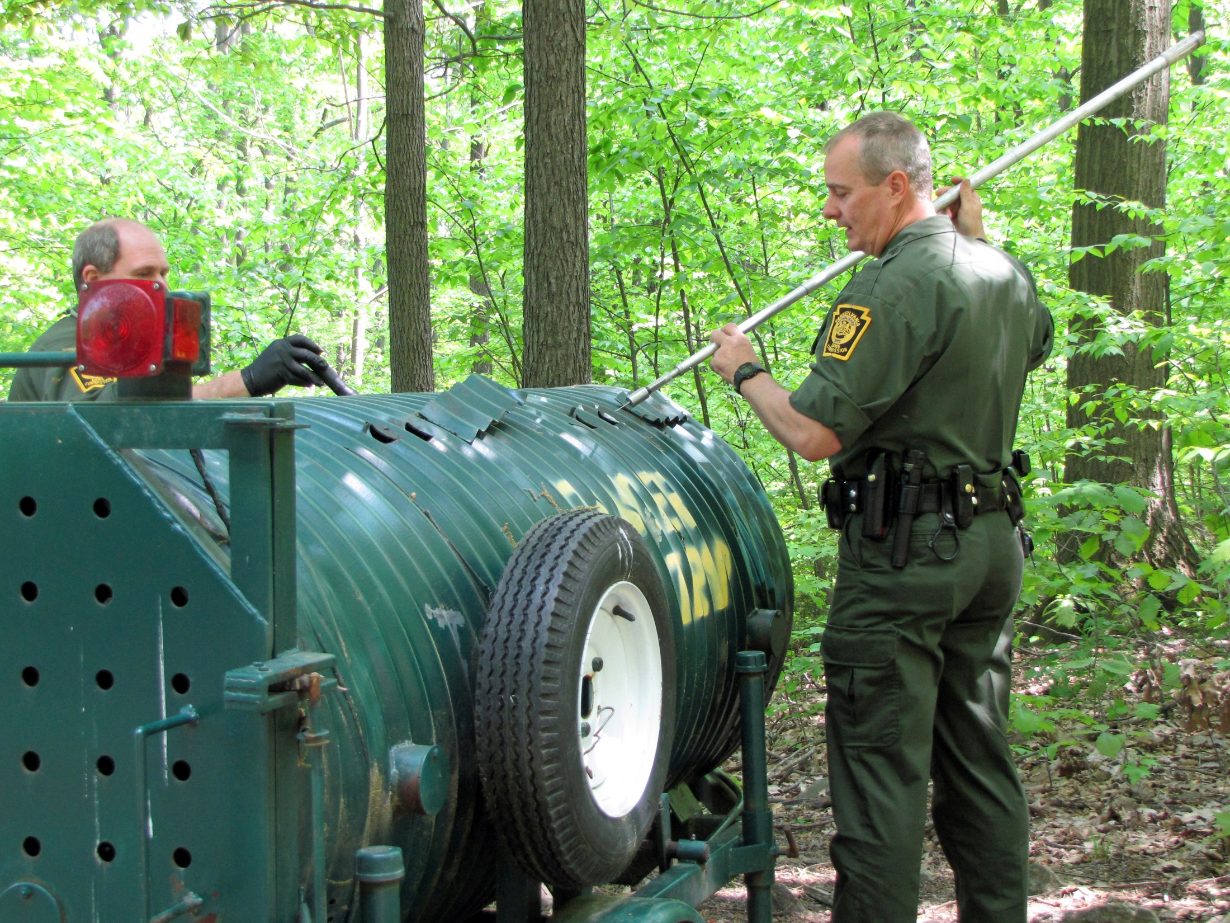
Notes:
Once a bear is caught, a tranquilizing drug is loaded into a jab stick. Small holes on the top of the trap allow for easy access. Care is taken to be sure that the needle is injected correctly.

Slide 6
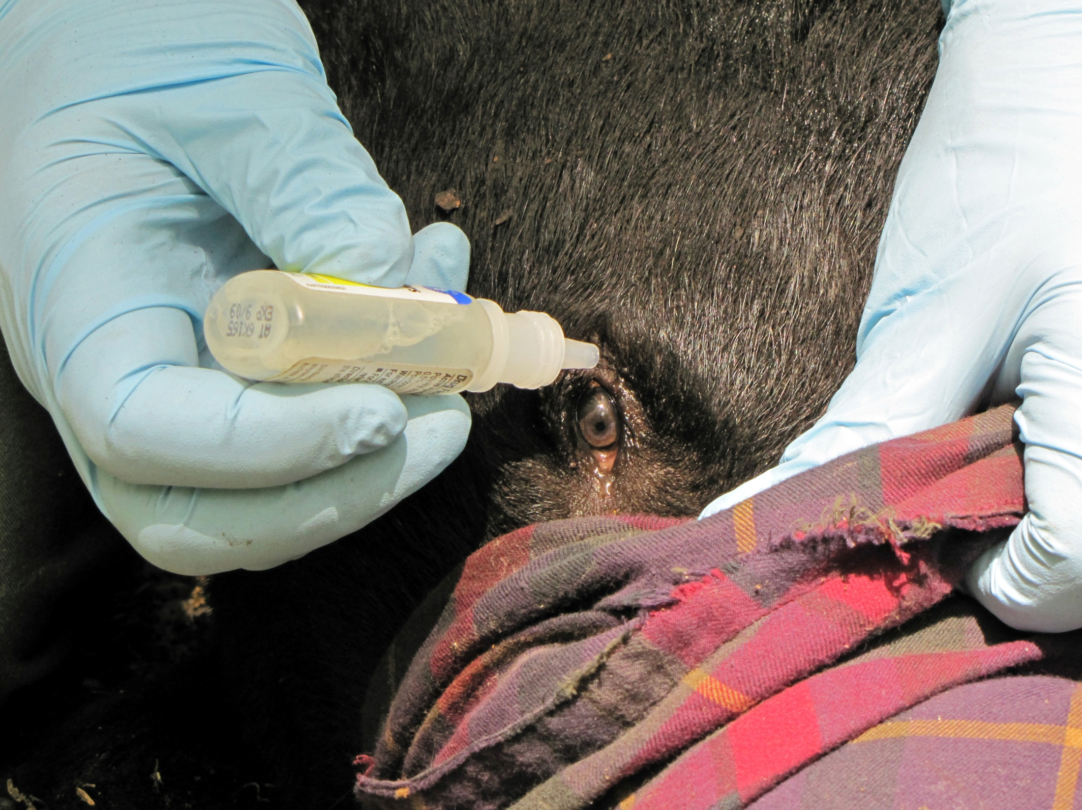
Notes:
The tranquilizing drugs prevent the bear from blinking. Eye drops and a blindfold are used to protect the eyes and keep the bear calm while being processed.

Slide 7
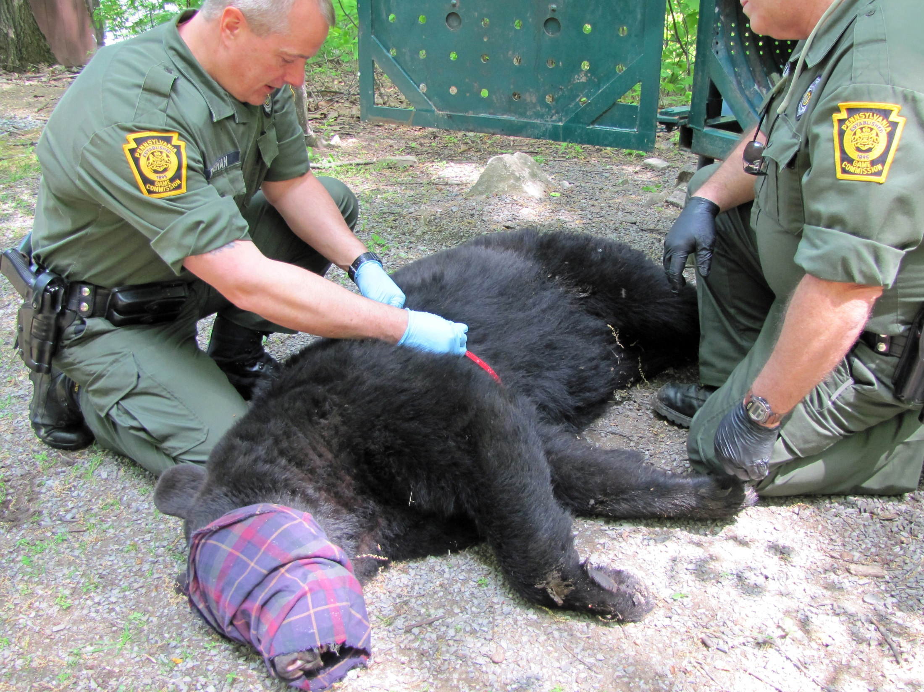
Notes:
The weight of the bear is estimated by using a chest tape.

Slide 8
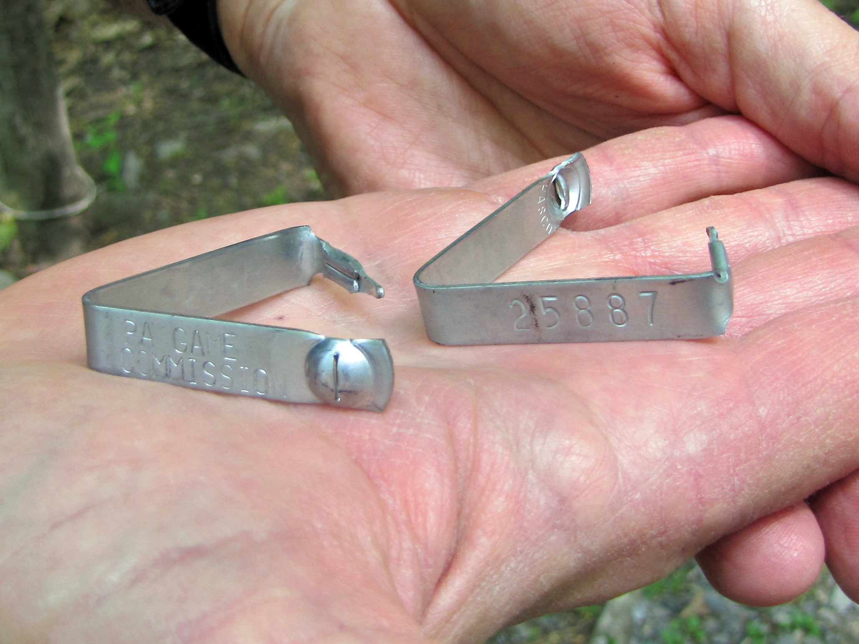
Notes:
Metal tags with unique numbers are placed in both of the bear’s ears using special pliers that close the tags.

Slide 9
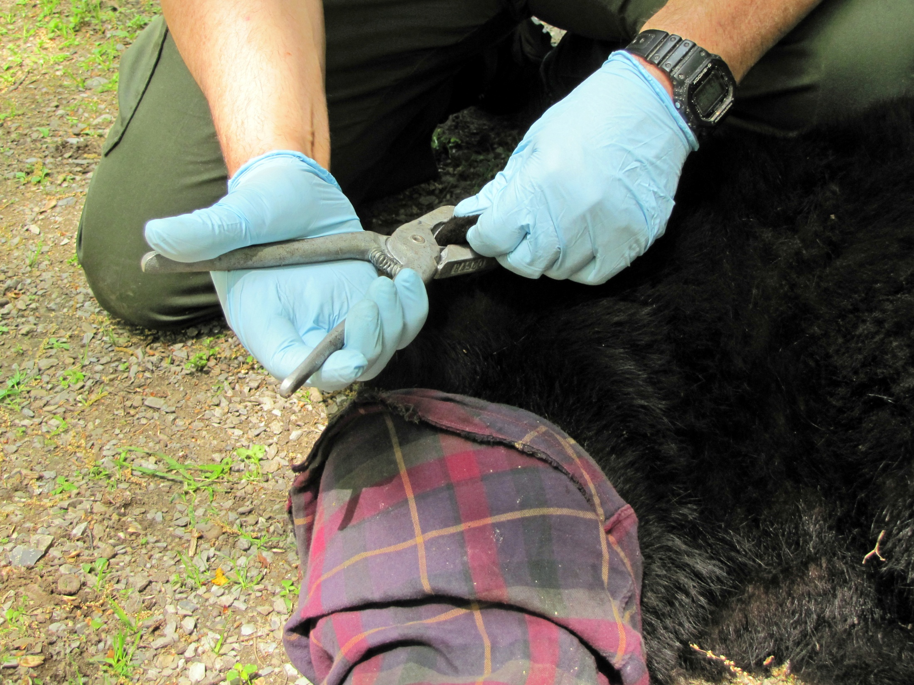
Notes:
Tags allow the bear to be identified in the event it is re-captured or harvested. This information allows us to study their range and distribution.

Slide 10
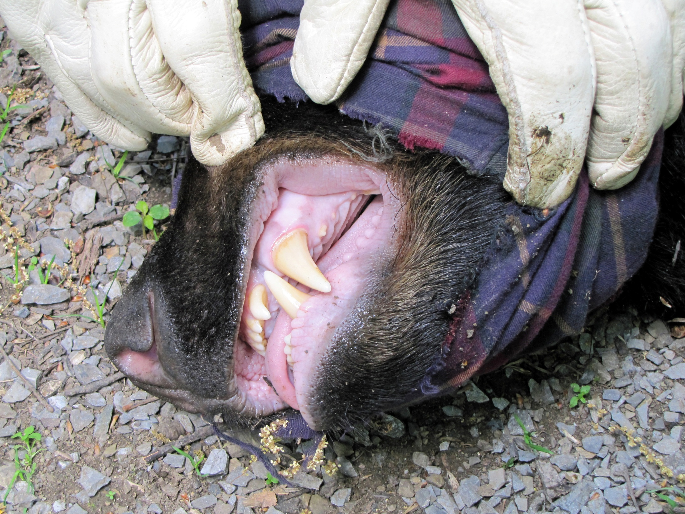
Notes:
To determine the age of the bear, a small premolar tooth located directly behind the large canine tooth is removed. They are located on both sides of the top and bottom jaws and are not necessary for the bear to eat or survive.

Slide 11
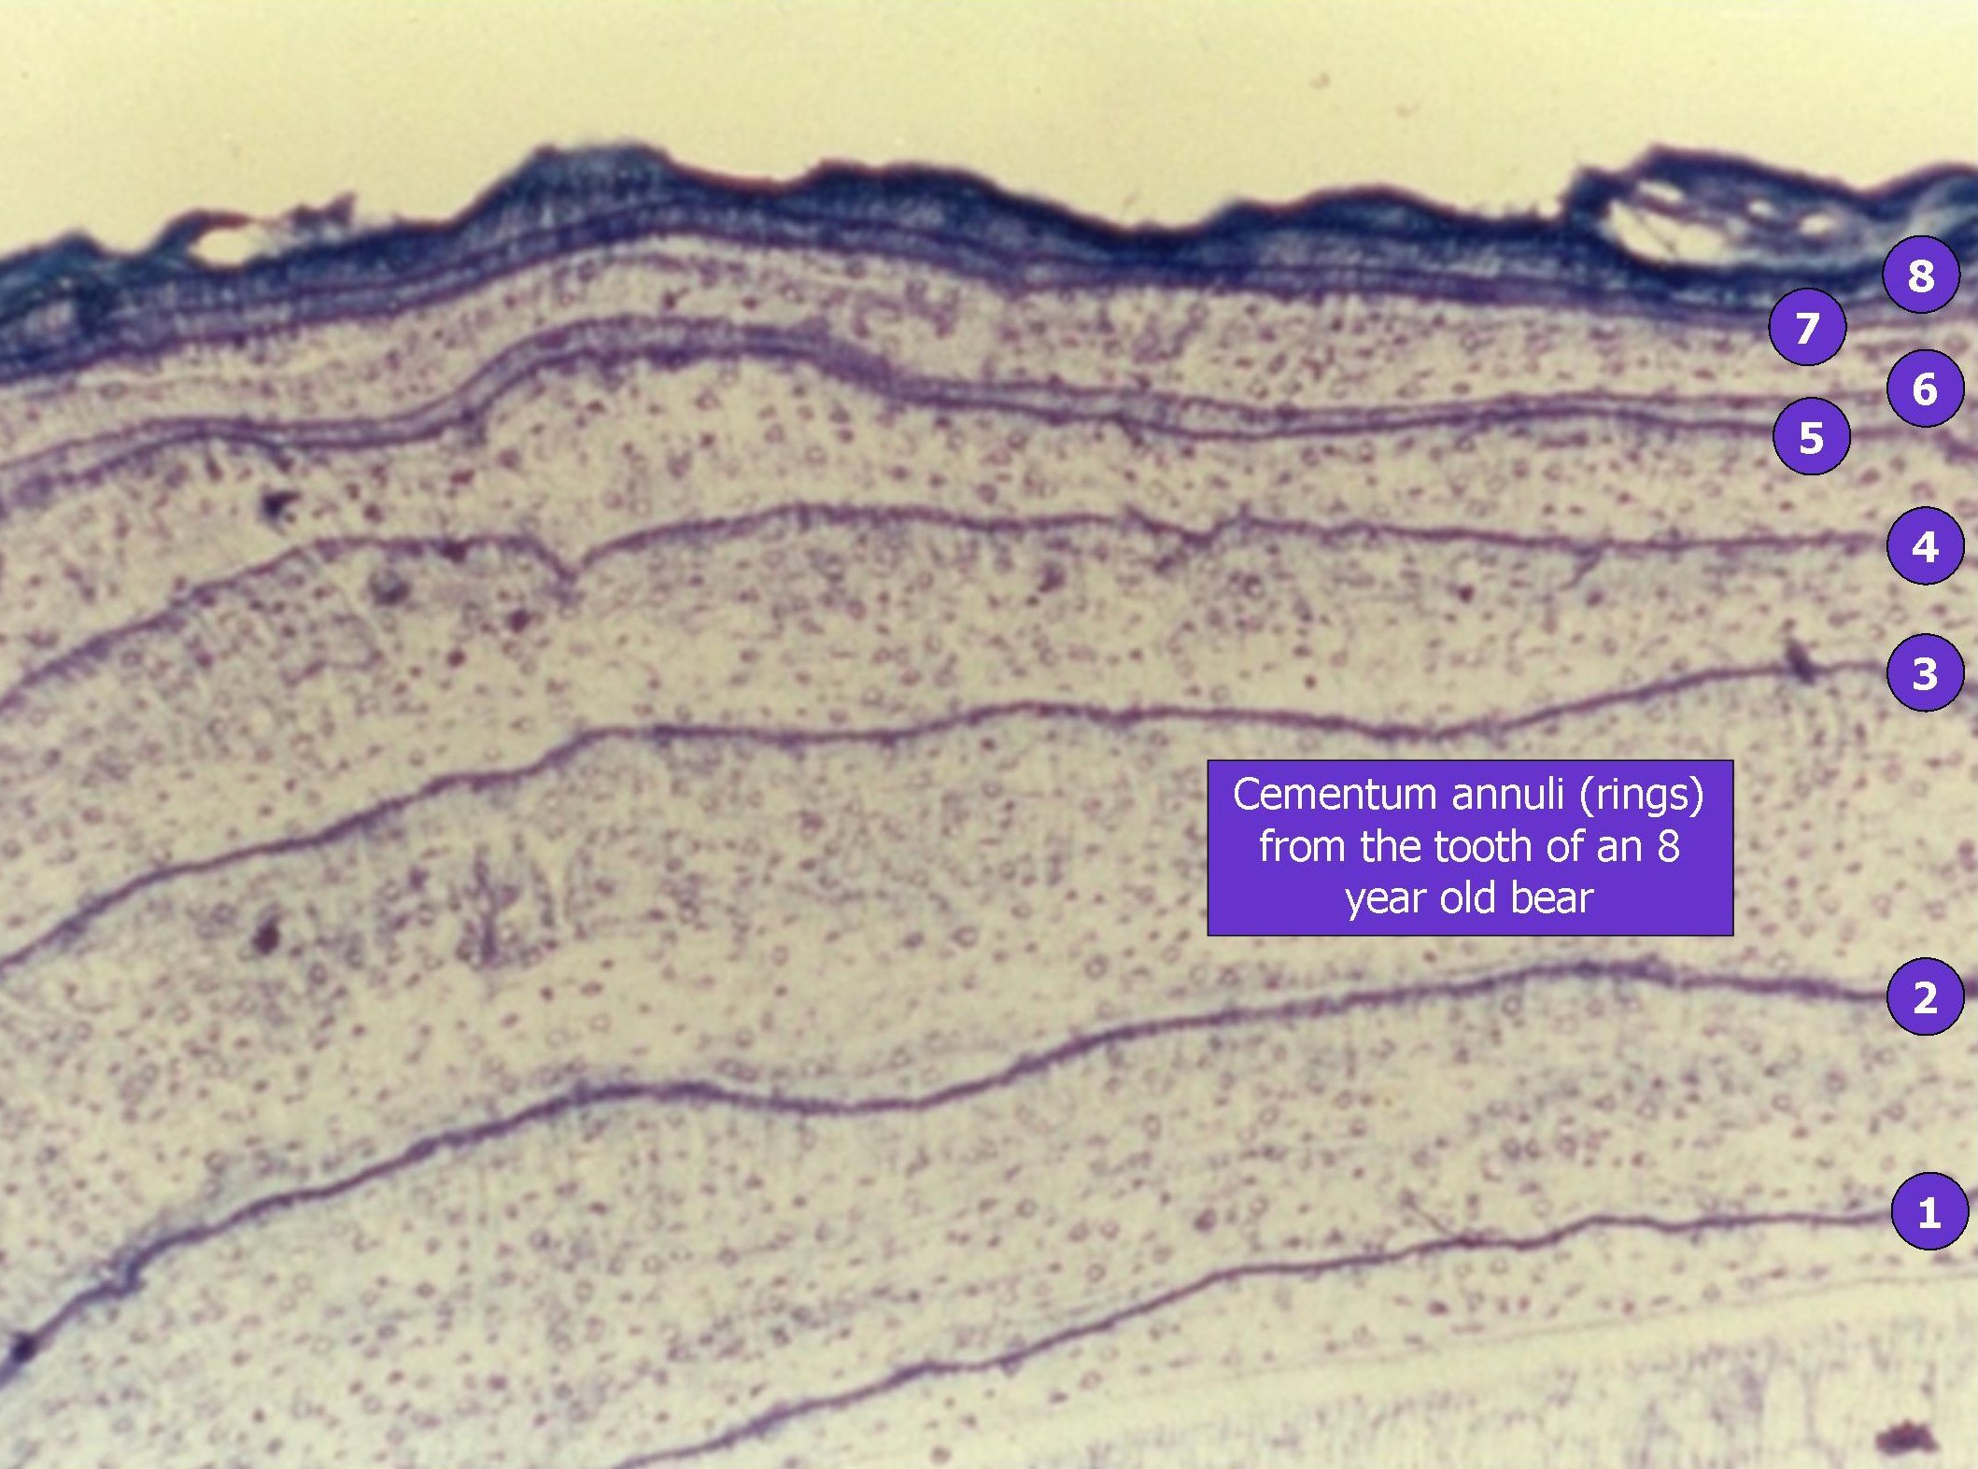
Notes:
In a lab, a thin cross section is cut from the root of the tooth and placed under a microscope. Growth rings (called cementum annuli) are counted to determine the age, much like aging trees by counting their growth rings.

Slide 12
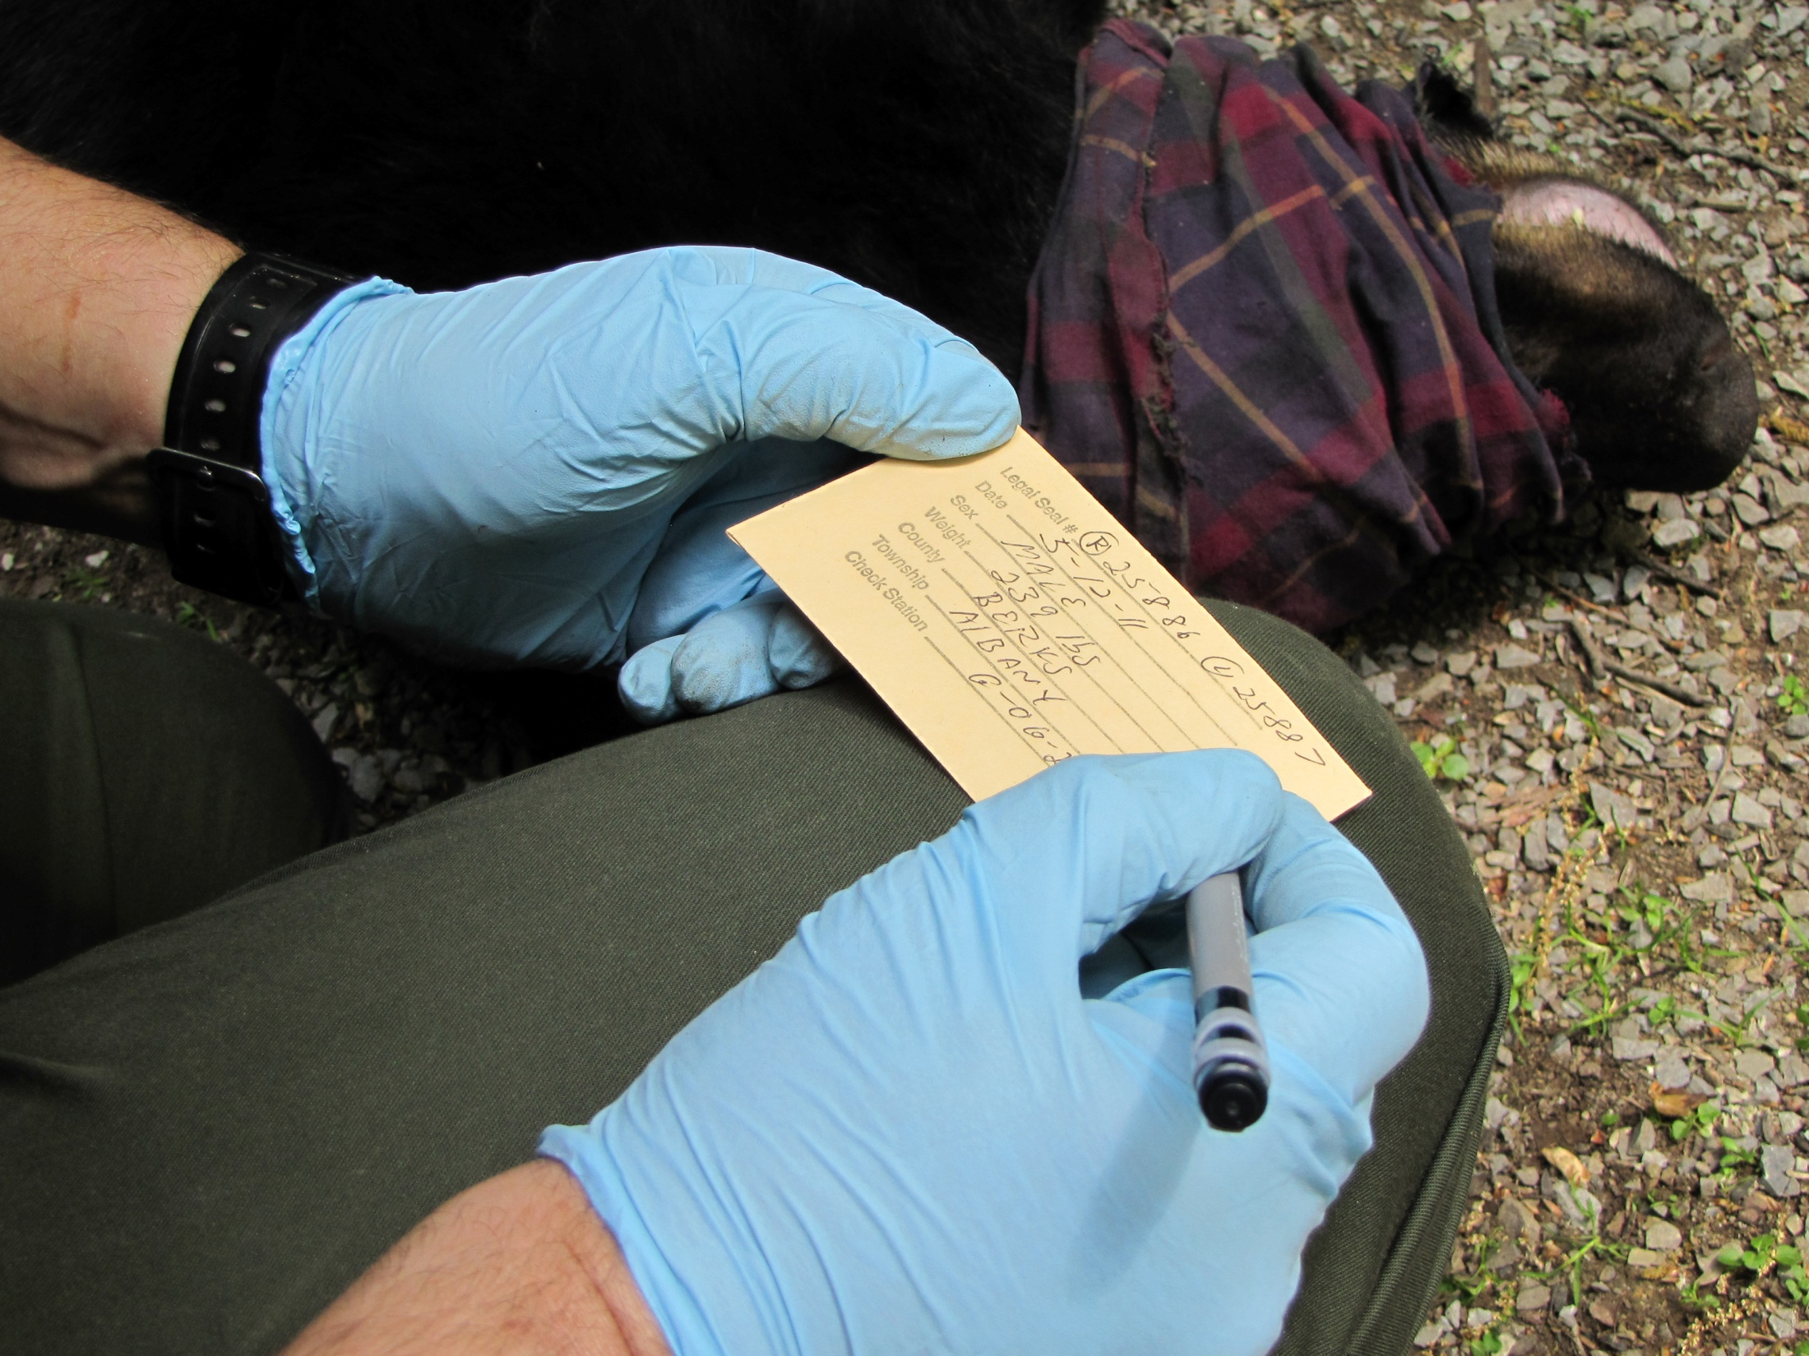
Notes:
All of the data taken from the bear is recorded. Data includes tag numbers, weight, sex and location of where the bear was trapped. This information goes into a computer data base for future reference and research.

Slide 13
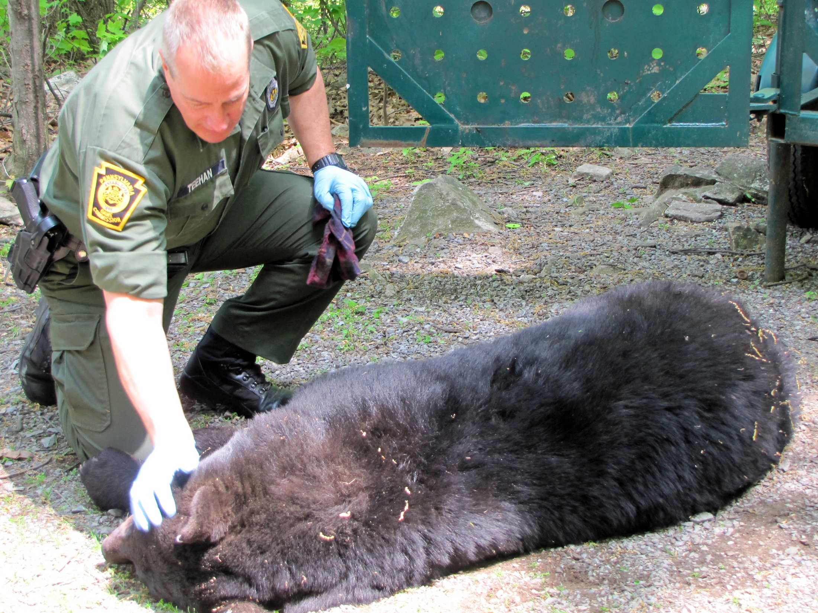
Notes:
Even after the bear is processed, it is closely monitored until it “wakes up.” The blindfold is removed and the bear is placed in a position to aid respiration and recovery.

Slide 14
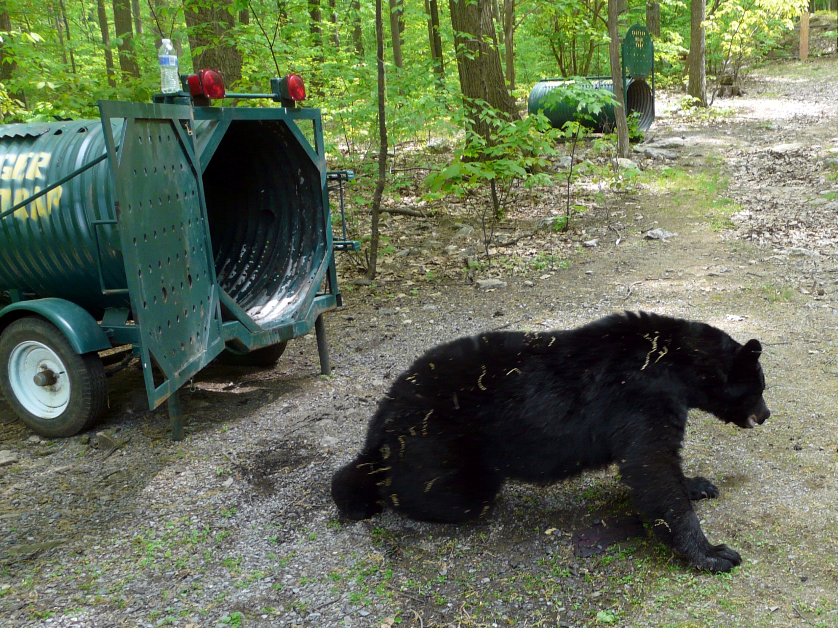
Notes:
Occasionally the bear is given an “antagonist” drug to help it recover faster or it may be allowed to recover on it’s own.

Slide 15
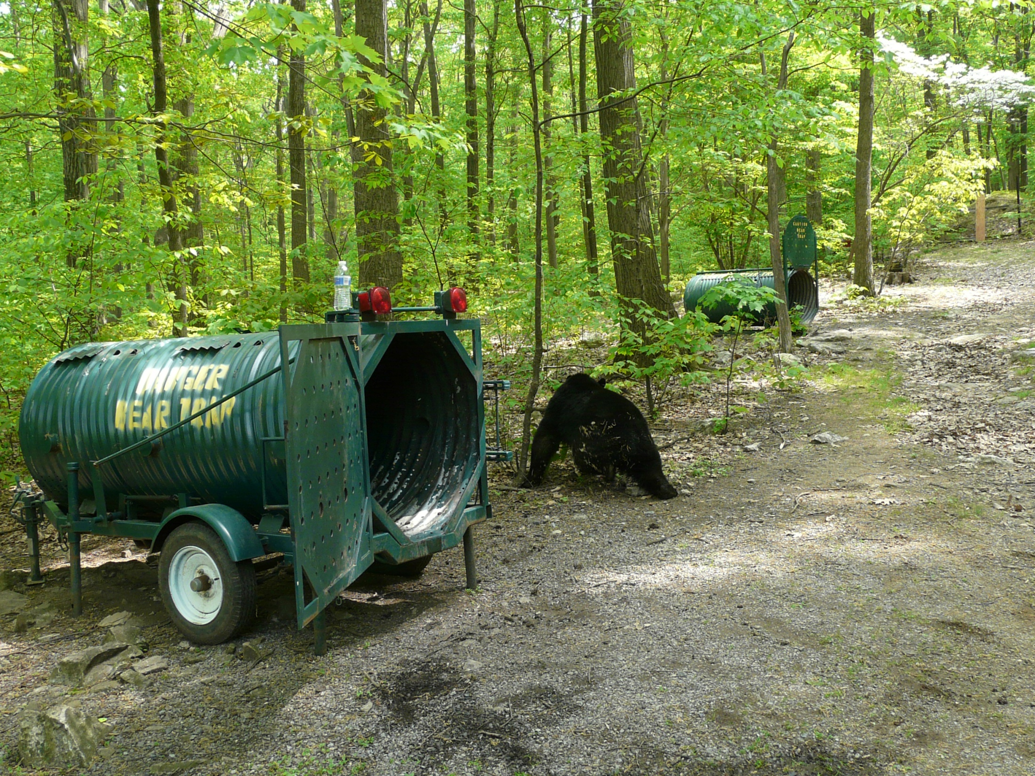
Notes:
Regardless of the method used, when the bear wakes up it is a little groggy and a bit shaky on it’s feet.

Slide 16
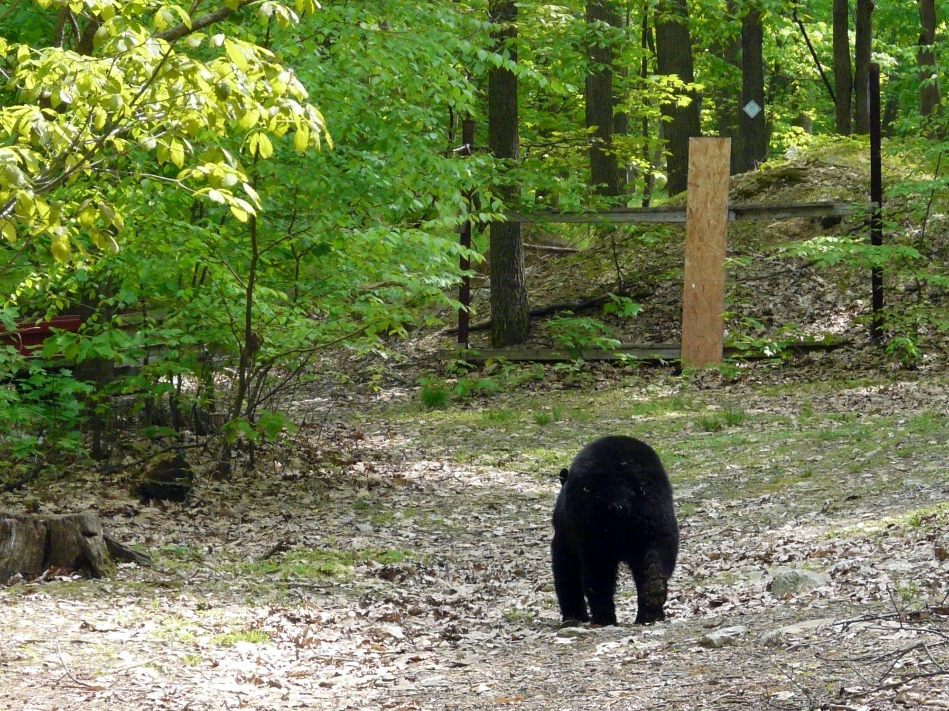
Notes:
In a very short time, the bear is able to walk normally and heads for the bushes to take a nap and sleep off the remaining effects of the tranquilizing drug.

Slide 17
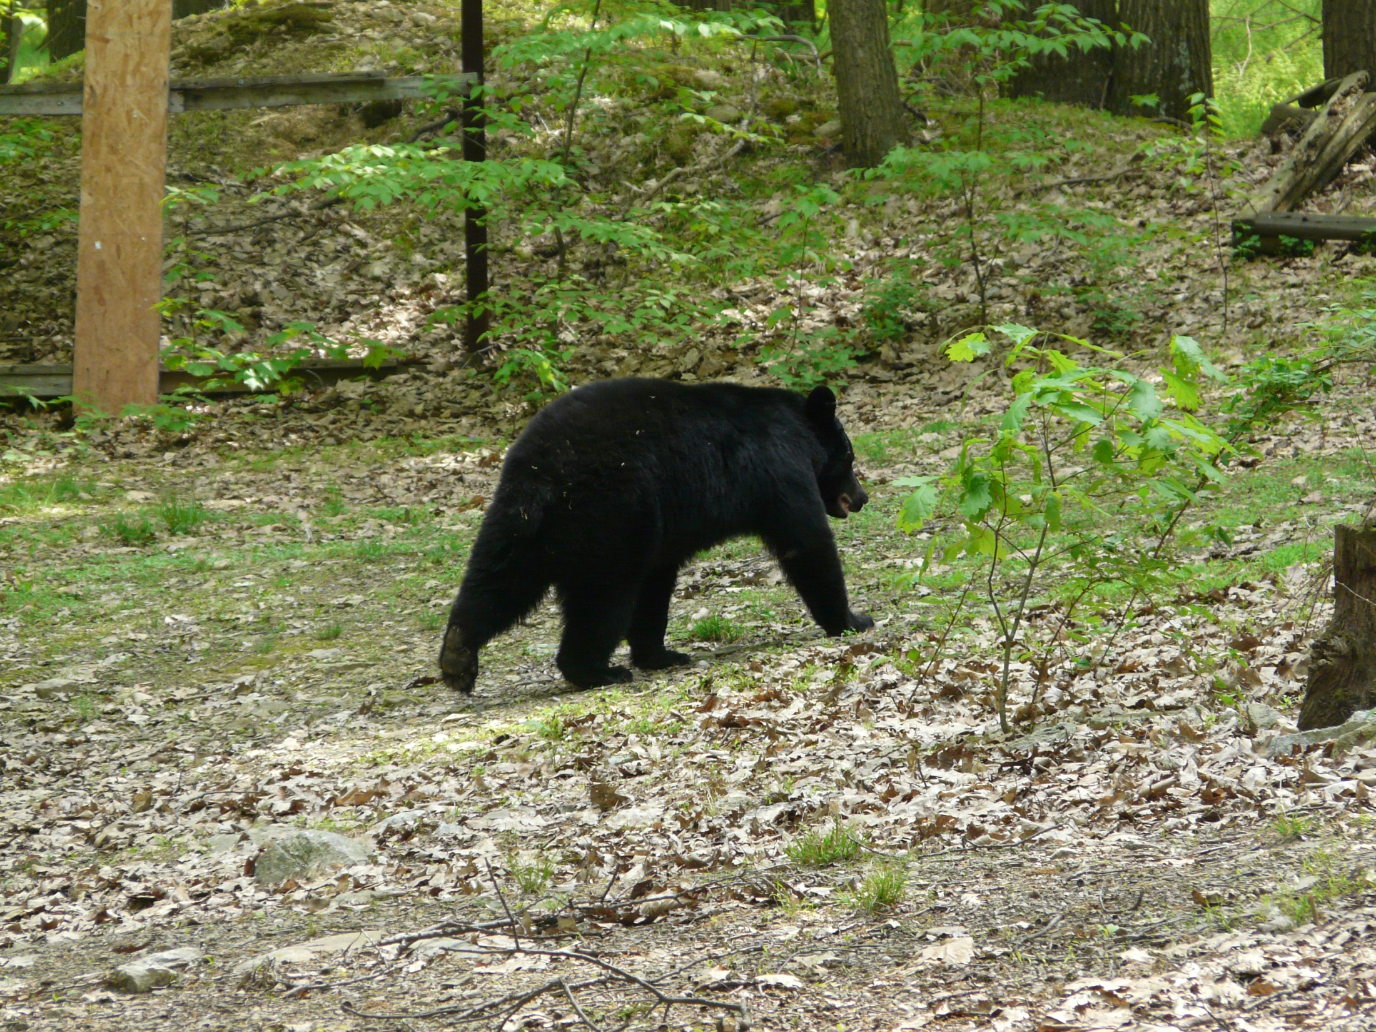
Notes:
The entire experience has no lasting effect on the bear.

Slide 18
We hope you enjoyed
the program!
Thank-you!
Pennsylvania Game Commission

