Slide 1
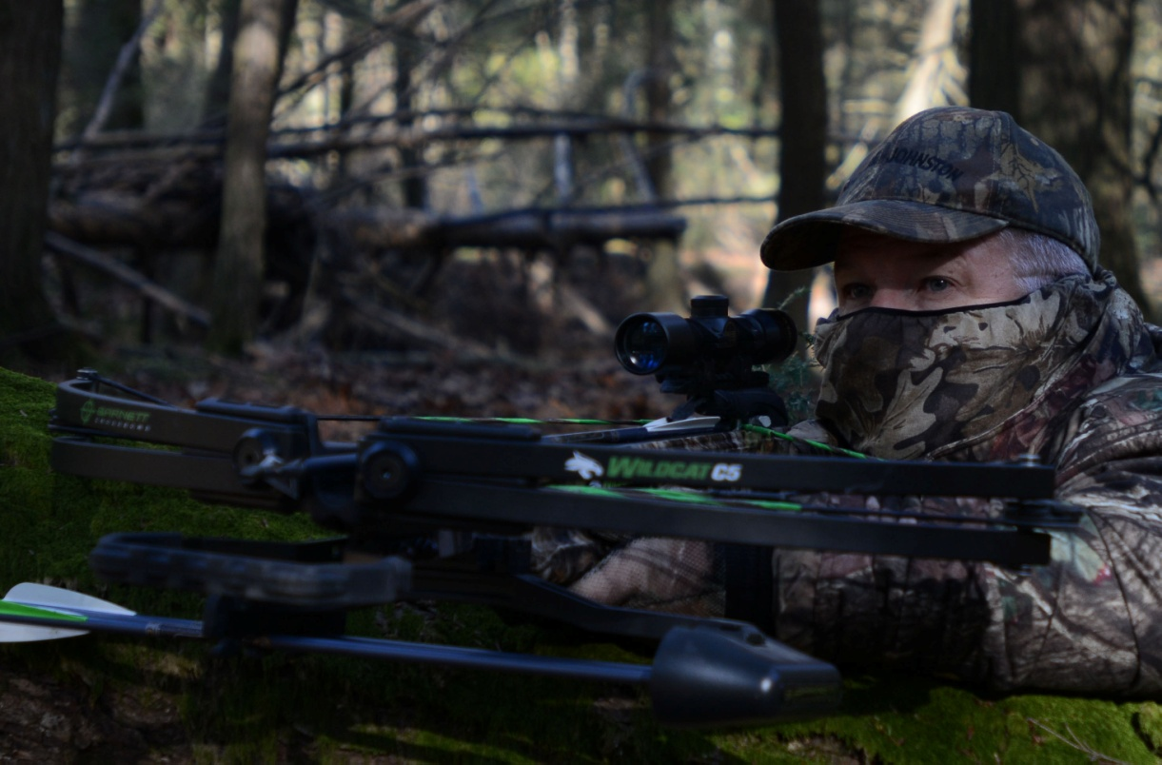
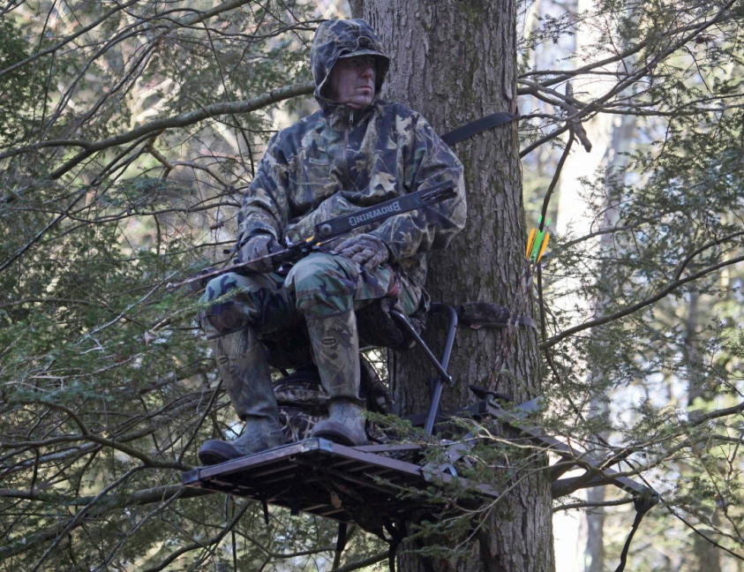
Archery Hunter Survey May 2014
Bureau of Information and Education
Pennsylvania Game Commission
Coren P. Jagnow
Joseph J. Neville

Slide 2
Background
Crossbows allowed during archery season beginning in 2009-10
Previously only allowed for used by disabled hunters, general firearms or in Special Regulations Areas (SRA’s)
BOC requested information about crossbow hunting participation and motivations
Before beginning mail survey crossbow hunters were interviewed
Information obtained from these hunters was used in the construction of the questionnaire

Slide 3
Mailings and Response Rate
Postcard sent to 2,811 licensed archery hunters in February 2014
Used protocol that replicated 2013-14 SCORP survey
One mailing asking them to complete it online
Phone number was provided for hunters to call to receive a paper copy
461 surveys used in analysis
167 undeliverable
17.4% response rate

Slide 4
Results
Almost 95% of the responding hunters had purchased an archery license before 2013/14
Less than 5% said it was their first, the rest (<1% were unsure)
When asked which best describes their past archery hunting participation in PA:
86.6% said they get a license every year
8.7% said they usually buy one (3 or 4 times out of 5 years)
1.9% said they buy a license less than half the time
2.8% said they rarely buy one

Slide 5
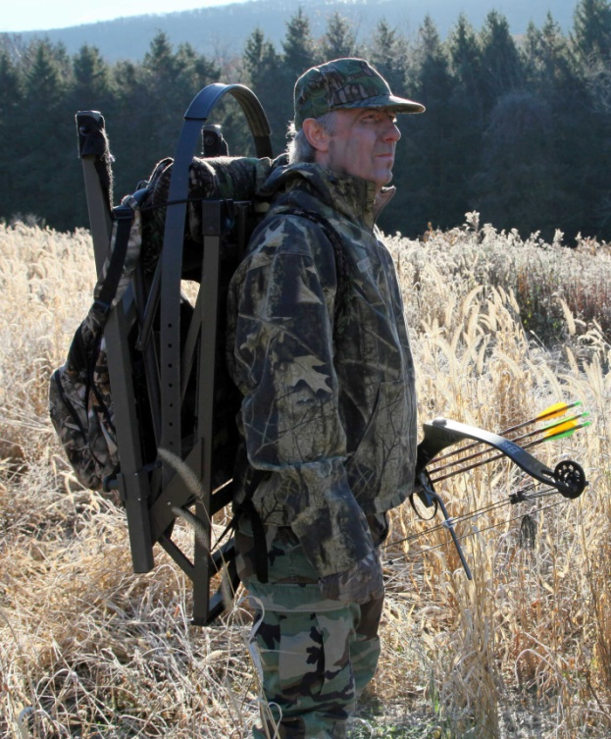
Archery Equipment
61% hunted with a crossbow in the 2013/14 season
Analysis of crossbow-specific questions are only analyzed with these hunters
94% hunted with another bow
Compound bow, long bow, recurve
50% of archery hunters use both
traditional bows and crossbows

Slide 6
Crossbow Hunters
16% have taken a mentored youth crossbow hunting
95% own a crossbow
Three-quarters of them purchased a crossbow after 2009 when crossbows became legal during the archery season
Almost 15% owned them before 2009 and used them with a disabled hunter permit
5% owned one before 2009 but did not use it during archery season
5% owned one before 2009 and used it to hunt in a special regulations area (SRA)

Slide 7
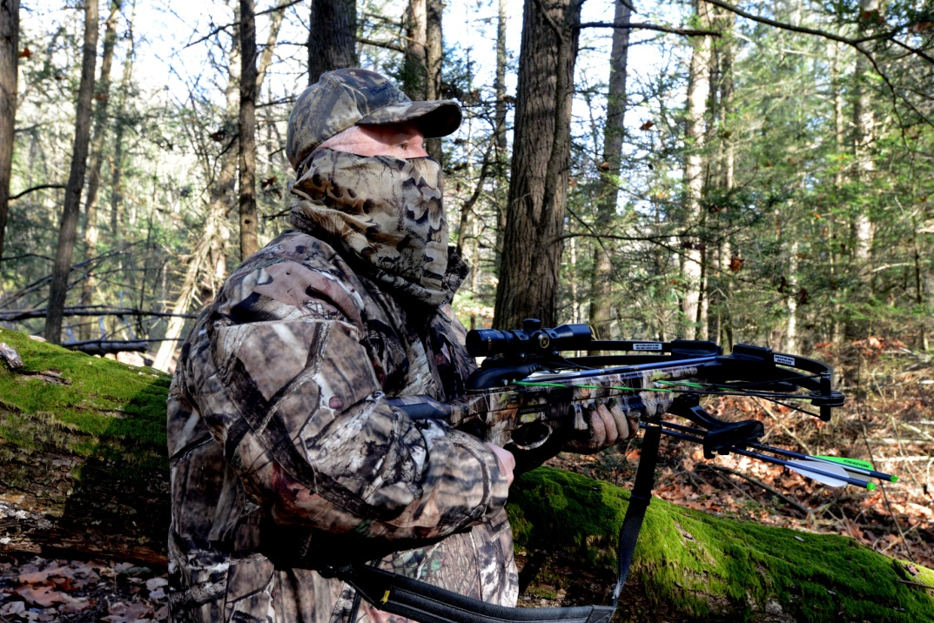
Crossbow Hunters
Would you still participate in archery hunting if crossbows were not permitted?
Yes 47% No 53%
Which species have you hunted with a crossbow?
Small Game 6.8%
Deer 99.6%
Bear 11.8%
Other 7.6%

Slide 8
Crossbow Hunting in Pennsylvania
 | Strongly Disagree | Disagree | Neither agree nor disagree | Agree | Strongly Agree
I have an injury that does not allow me to use traditional bows | 16.7 | 12.8 | 16.2 | 19.7 | 34.6
As I’ve gotten older I prefer to use a crossbow over traditional bows | 5.9 | 5.9 | 16.9 | 31.8 | 39.4
I am not able to pull the draw weight on traditional bows | 14.4 | 14.0 | 19.9 | 23.3 | 28.4
I like that hunting with a crossbow allows me to hunt earlier in the fall | 7.2 | 6.4 | 28.5 | 24.3 | 33.6
I purchased an archery license only because I took a mentored youth hunting with a crossbow | 43.3 | 29.6 | 22.3 | 1.7 | 3.1
I prefer using crossbows because they have scopes | 13.6 | 22.1 | 34.5 | 17.4 | 12.3
I hunt using a bow and crossbow each archery season | 12.8 | 17.9 | 23.0 | 22.1 | 24.3

Slide 9
Compared to hunting with traditional archery equipment, I believe that crossbows are:
 | Strongly Disagree | Disagree | Neither agree nor disagree | Agree | Strongly Agree
Heavier | 4.2 | 7.6 | 21.1 | 40.9 | 26.2
Easier to shoot | 1.3 | 5.5 | 13.6 | 42.4 | 37.3
More difficult to maneuver | 10.5 | 20.3 | 22.8 | 29.1 | 17.3
Noisier | 7.7 | 18.8 | 21.8 | 34.2 | 17.5
Easier to harvest an animal on the first shot | 23.8 | 5.1 | 13.2 | 28.9 | 28.9
More easily detected by the animal I am attempting to shoot | 2.5 | 19.0 | 32.5 | 37.1 | 8.9

Slide 10
Mean scores
 | Mean |  | Mean
As I’ve gotten older I prefer to use a crossbow over traditional bows | 3.9 | Easier to shoot | 4.1
I like that hunting with a crossbow allows me to hunt earlier in the fall | 3.7 | Heavier | 3.8
I have an injury that does not allow me to use traditional bows | 3.4 | Noisier | 3.4
I am not able to pull the draw weight on traditional bows | 3.4 | Easier to harvest an animal on the first shot | 3.3
I hunt using a bow and crossbow each archery season | 3.3 | More easily detected by the animal I am attempting to shoot | 3.3
I prefer using crossbows because they have scopes | 2.9 | More difficult to maneuver | 3.2
I purchased an archery license only because I took a mentored youth hunting with a crossbow | 1.9

Slide 11
Archery Hunters
Use of other sporting arms:
Rifle 87%
Muzzleloader 25%
Shotgun 56%
Flintlock 31%
Other 18%
Average age: 49.4 years
Pennsylvania residents: 94%
Gender
Male 98.6%
Female 1.4%

Slide 12
Summary
Sixty-one percent of archery hunters use a crossbow
Three-quarters of crossbow hunters who own their own crossbows purchased them after 2009
15% owned them before 2009 to use with a disabled hunter permit
Nearly 100% of crossbow hunters hunt deer
Crossbow hunters motivations include:
Age, physical limitations, and opportunity to hunt earlier
Majority of crossbow agree that crossbows are easier to shoot than traditional bows, but that they are also heavier and noisier
Eighty-seven percent of archery hunters hunt with a rifle

